Slide 2
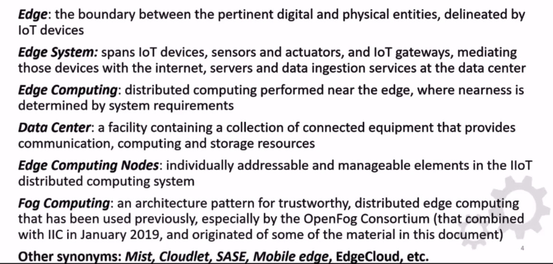
Some Terminology
Notes:
SASE (Secure Access Service Edge)

Slide 3
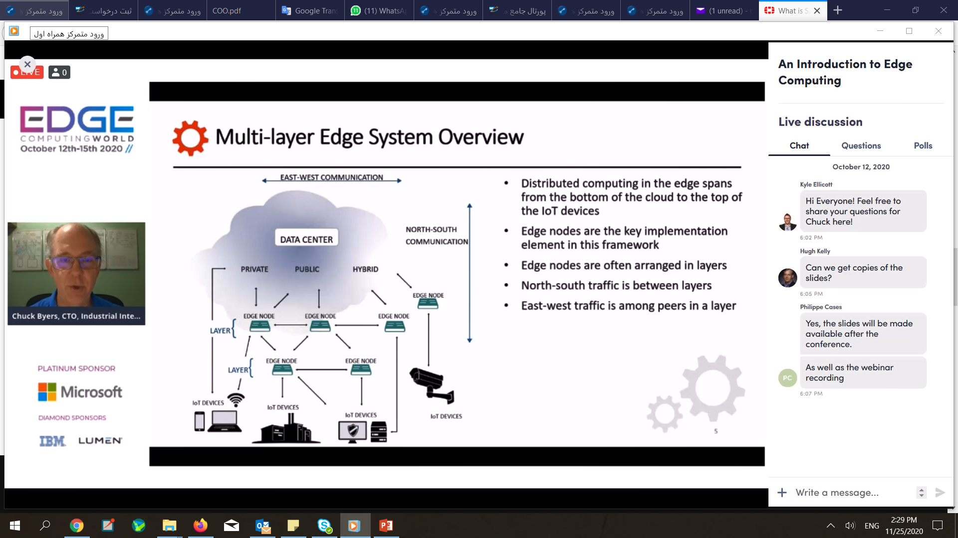

Slide 4
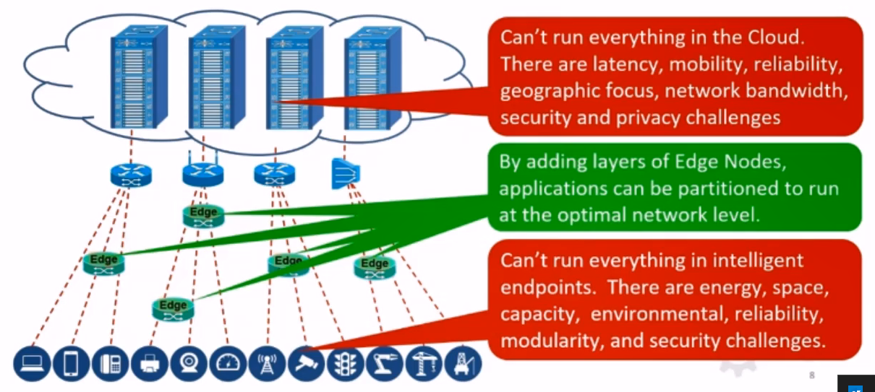
The need for Edge Computing

Slide 5
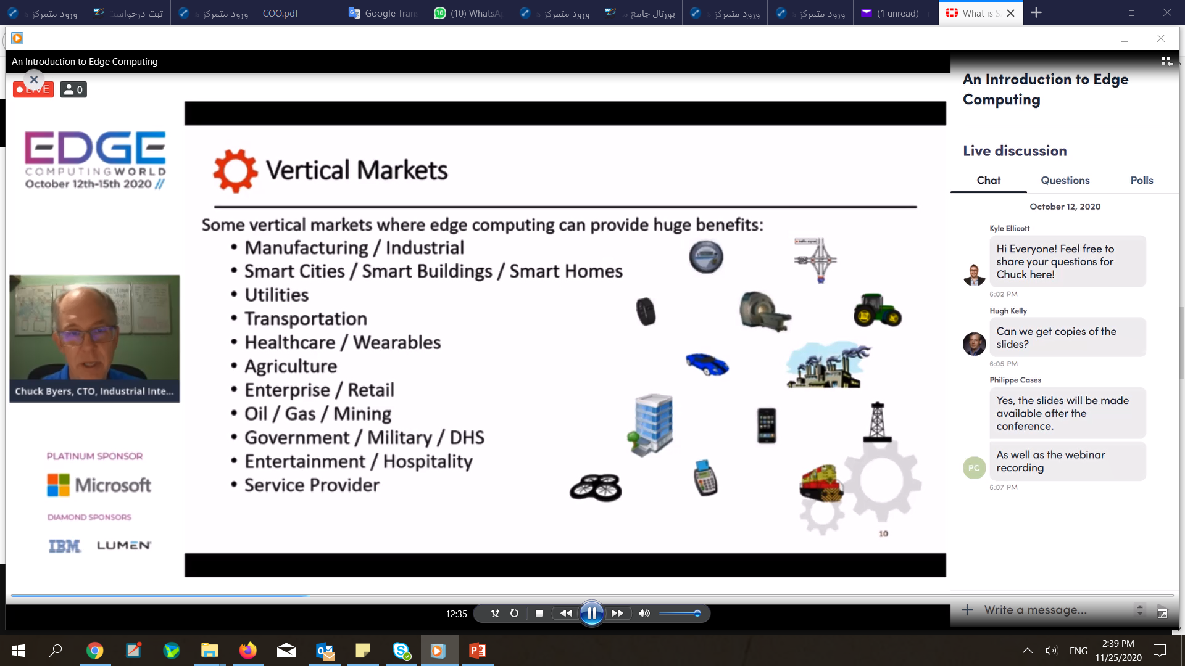

Slide 6
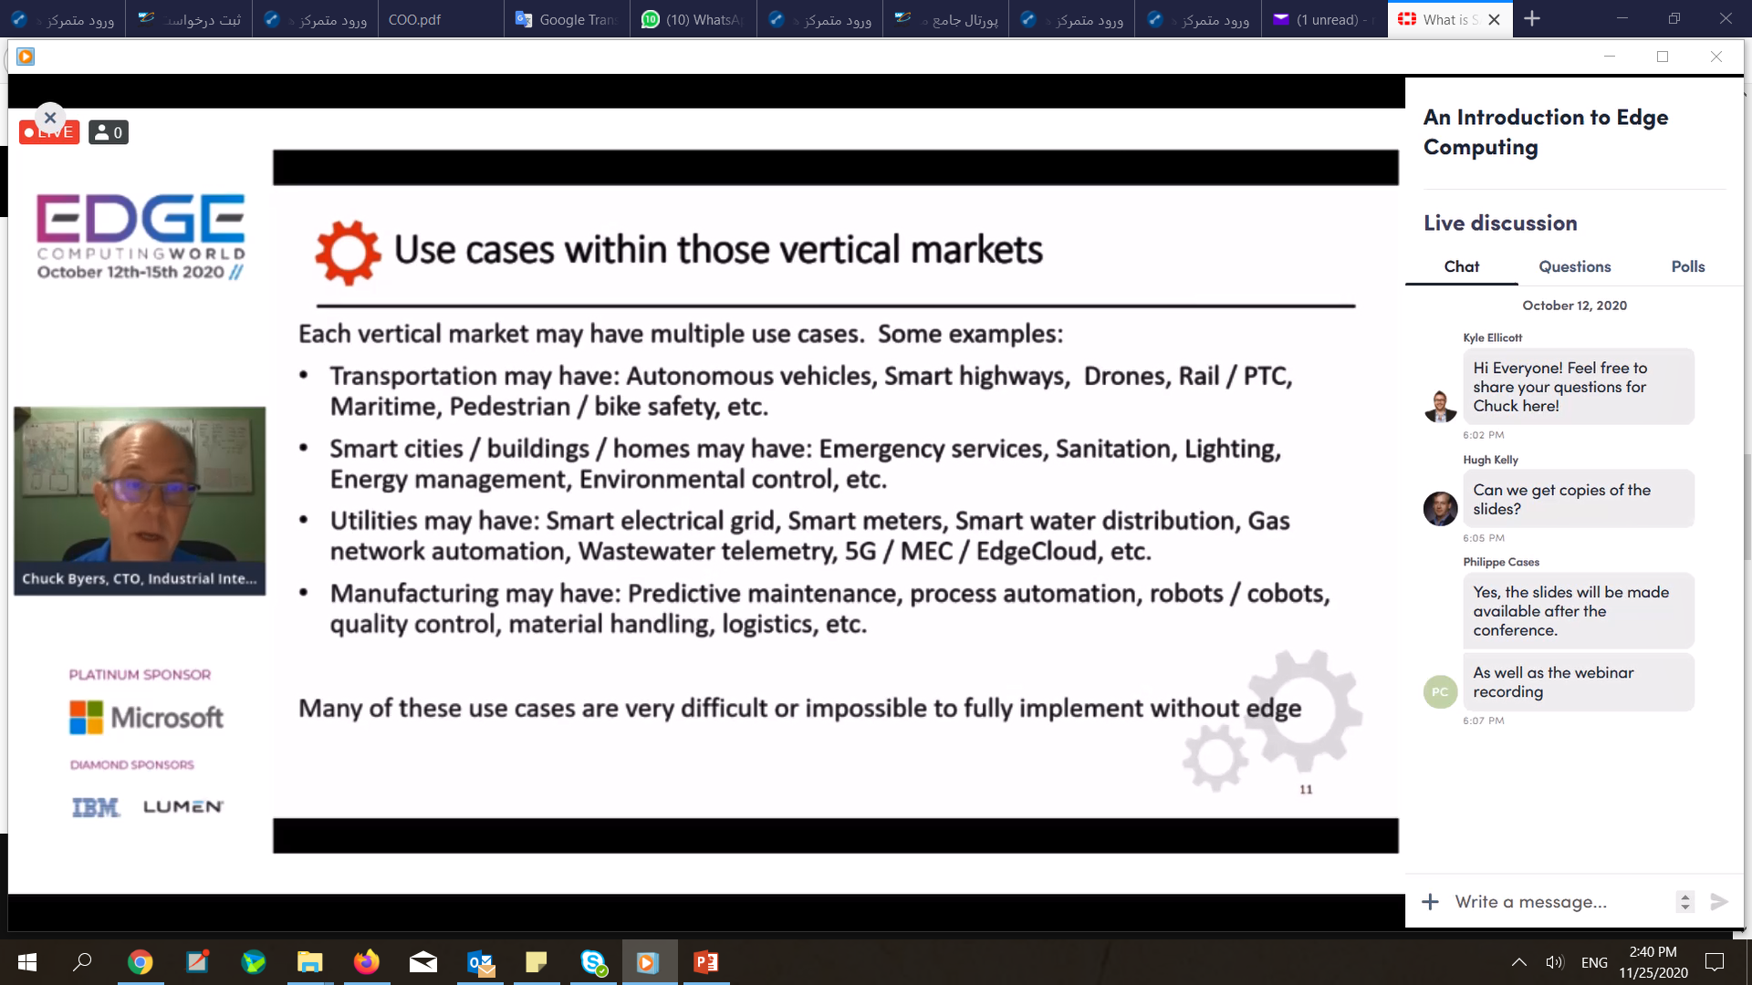

Slide 7
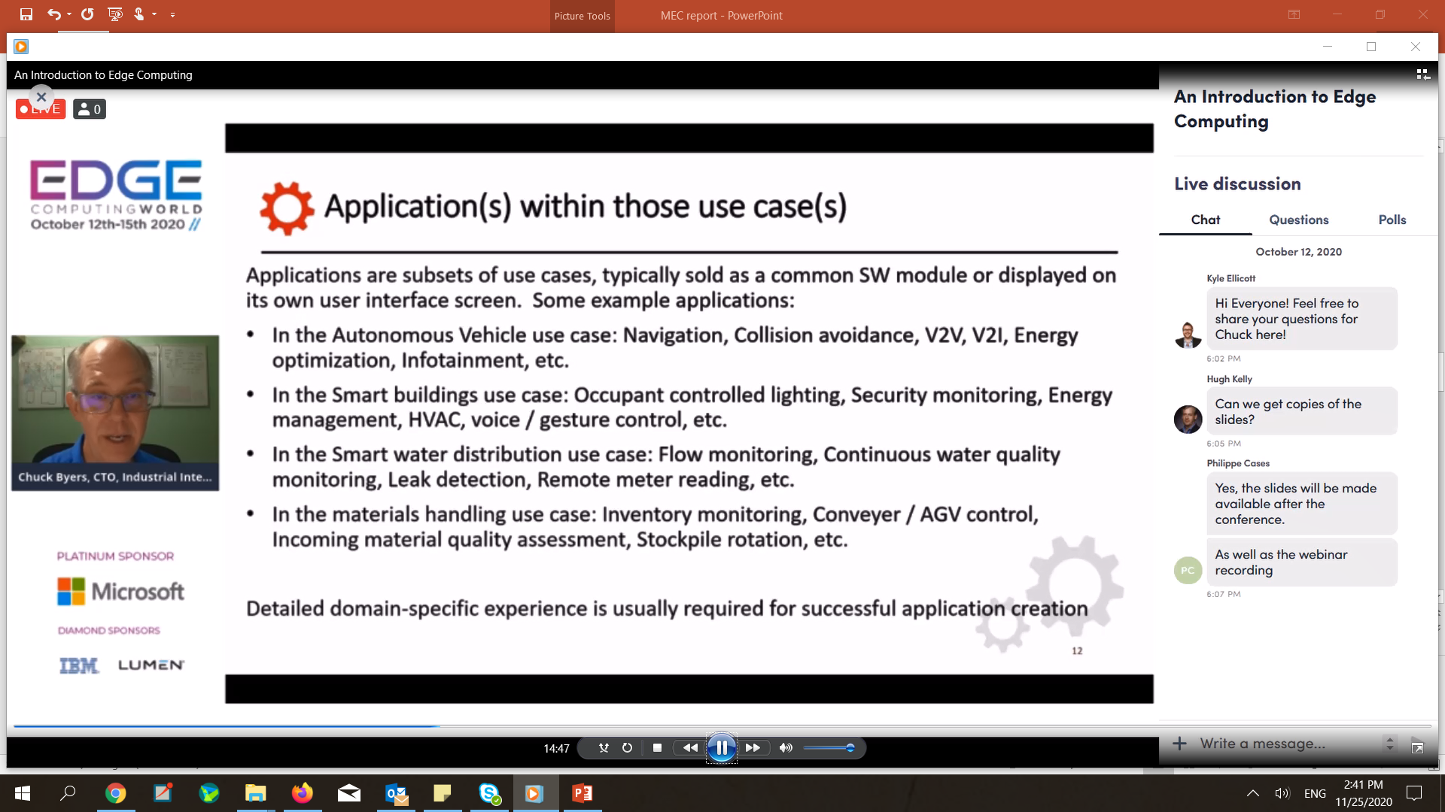

Slide 8
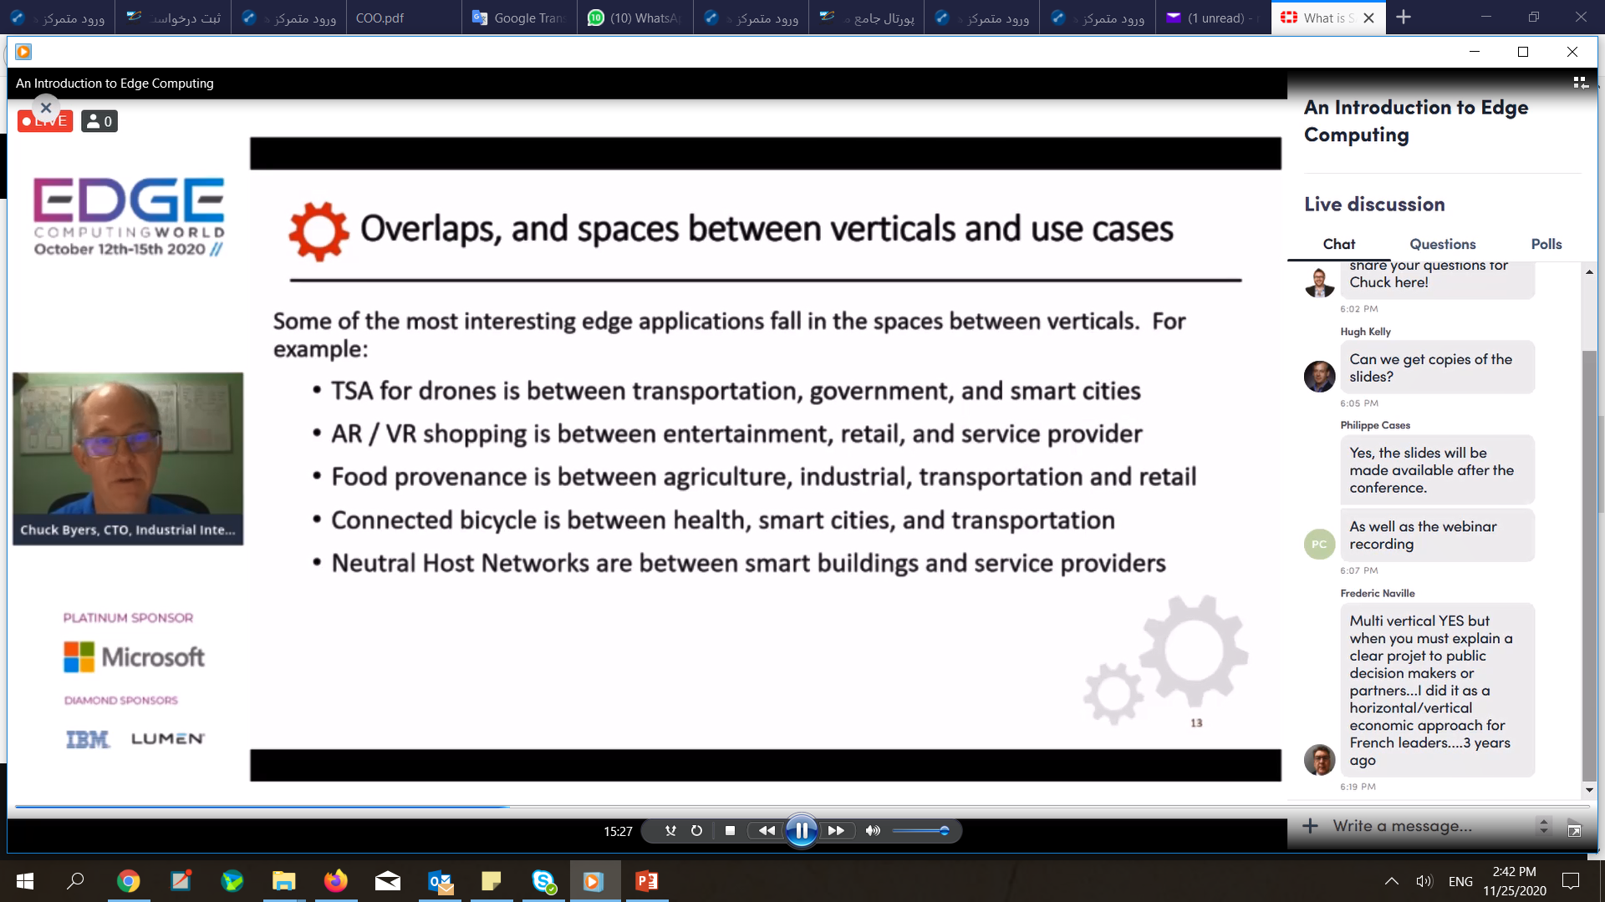

Slide 9
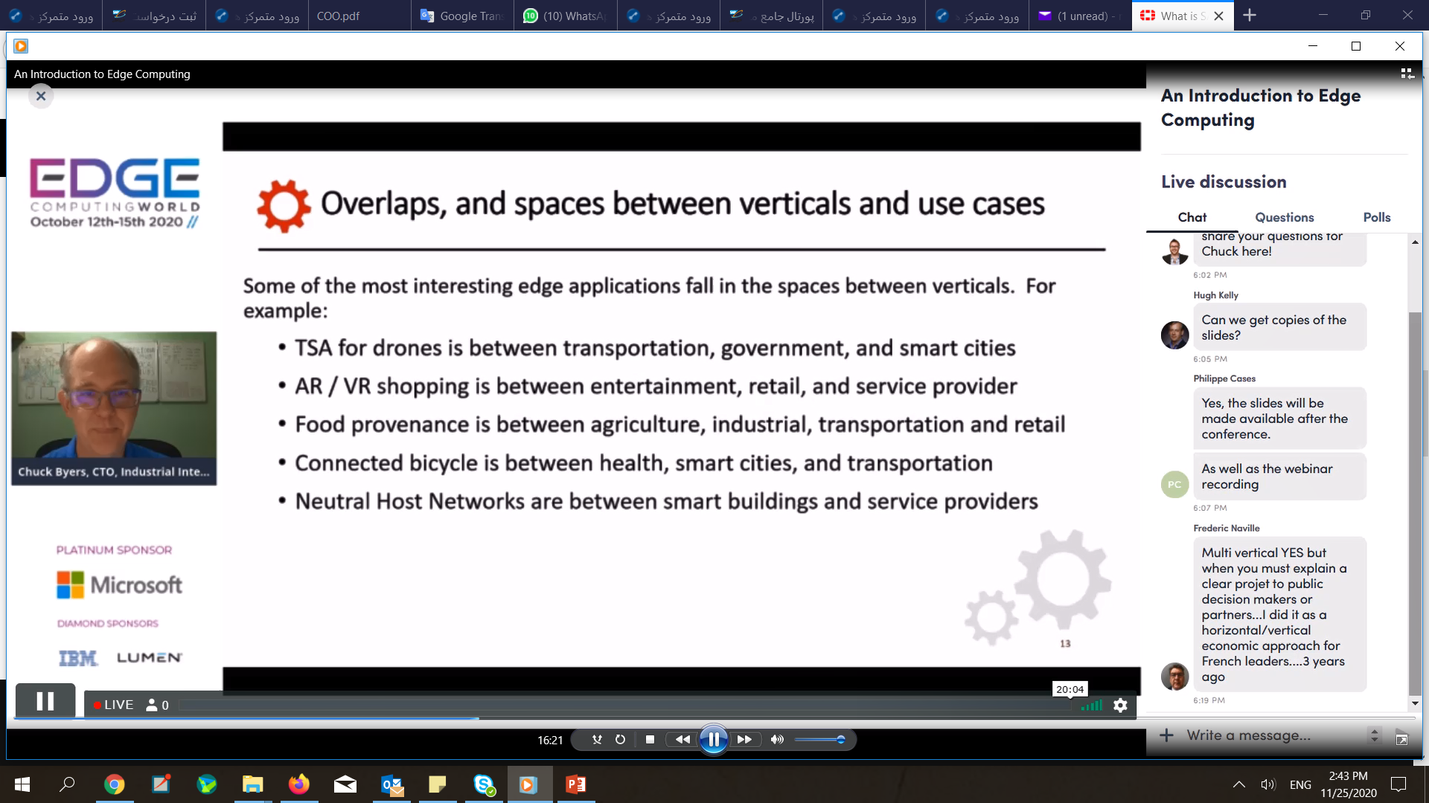

Slide 10
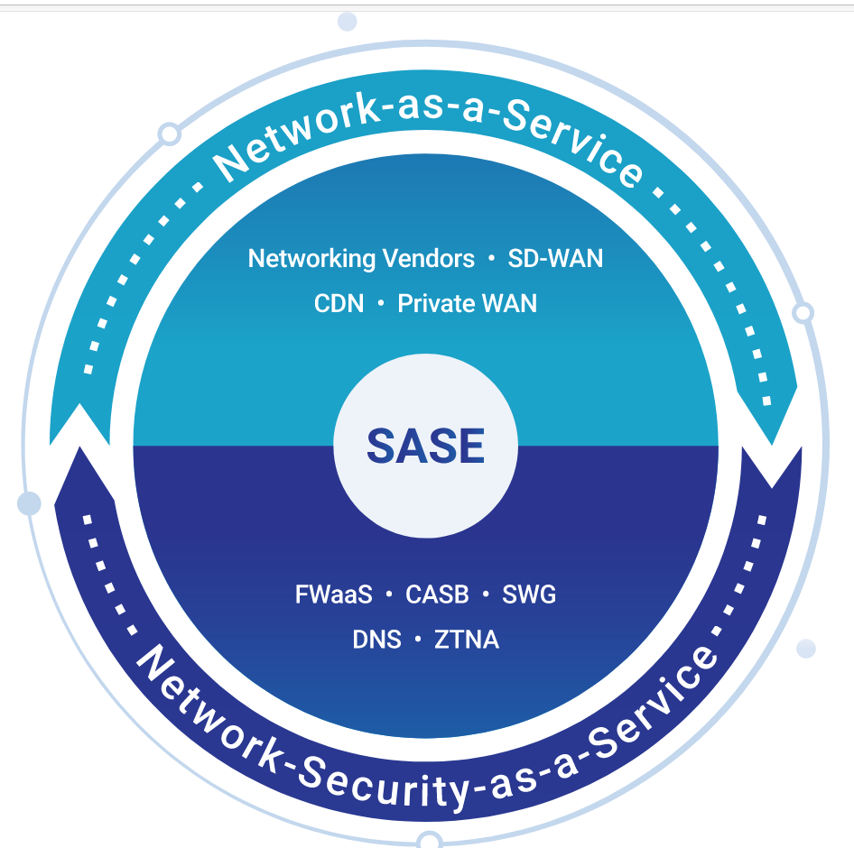

Slide 11
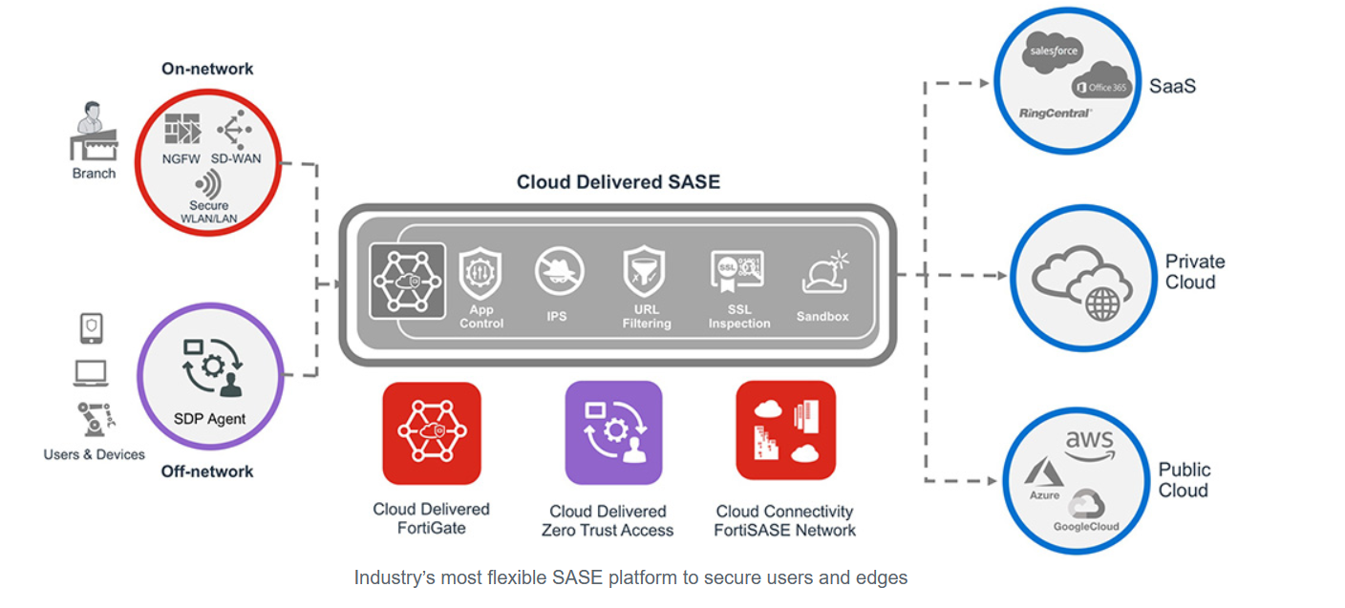
Notes:
Secure SD-WAN: Advanced WAN networking functions, such as dynamic path selection, self-healing WAN capabilities, support for demanding high-performance applications, and consistent user experience, are the core of a SASE solution.
Zero-trust Network Access, while an essential SASE component, is more of a framework than a product as it includes several technologies working together. Within a SASE strategy, ZTNA’s primary job is to authenticate users to applications. Advanced context and role-based identity combined with multifactor authentication (MFA) are essential for securing access for users and devices, for both on and off-network.
A NGFW (physical) or FWaaS (cloud-based) firewall: SASE also needs flexible security offering at the Edge and Cloud-delivered offering to protect Edges and users both on-network and off-network. A hybrid security strategy is required by organizations to enable internal segmentation preventing guests and/or Internet-of-Things(IoT) threats and at the same time enabling consistent security policies for users who are off the network.
A Secure Web Gateway is used to protect users and devices from online security threats by enforcing internet security and compliance policies and filtering out malicious internet traffic. It can also enforce acceptable use policies for web access, ensure compliance with regulations, and prevent data leakage.
A CASB service enables organizations to take control of their SaaS applications, including securing application access and eliminating Shadow IT challenges. Combining CASB with on-premises DLP further as an integrated system will also further ensure the protection of critical data.

Slide 12
Benefits of SASE
When properly implemented, a SASE approach allows organizations to apply secure access no matter where their users, workloads, devices, or applications are located. This becomes a critically important advantage as more users join a remote workforce, SaaS applications see rapid adoption, and data moves rapidly among data centers, branch offices, and hybrid- and multi-cloud environments.
Flexible, consistent security: Deliver a comprehensive range of security services, from threat prevention to NGFW policies, to any edge, ensuring zero-trust network access to know who is on your network, know what is on your network, and protect assets both on and off the network
Reduced total cost of ownership: Conquer point product sprawl once and for all by using a single platform approach and reducing or eliminating capex and opex costs
Reduced complexity: Simplify your architecture by consolidating key networking and security functions from disparate point products into single solutions, all easily managed from a single-pane-of-glass management system
Optimized performance: Leveraging cloud availability, your team members easily and securely connect to the Internet, applications, and corporate resources wherever they are located.

Slide 13
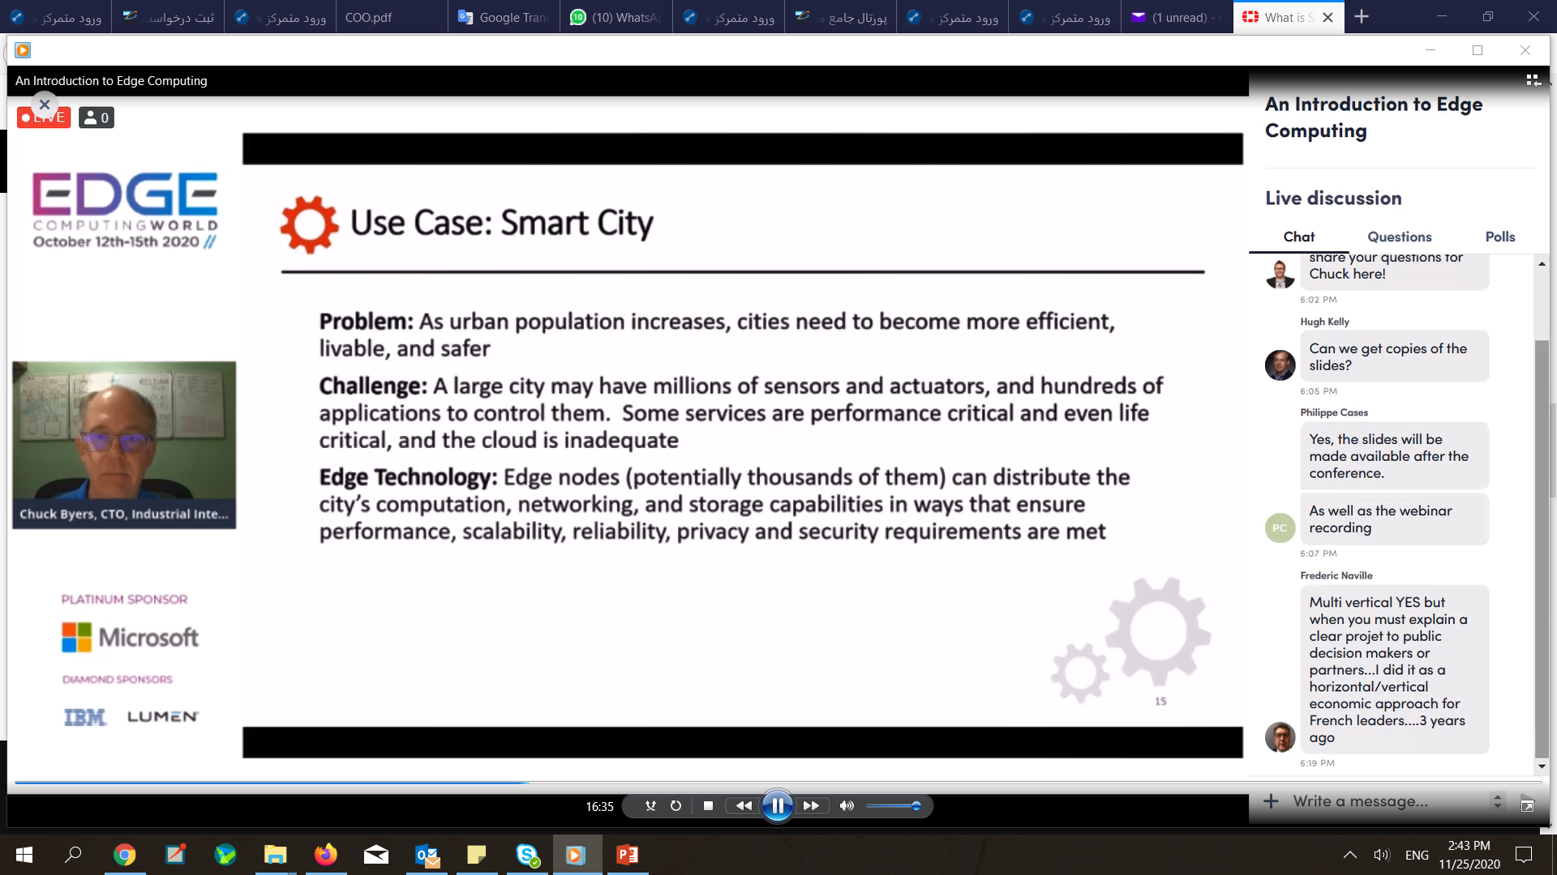

Slide 14
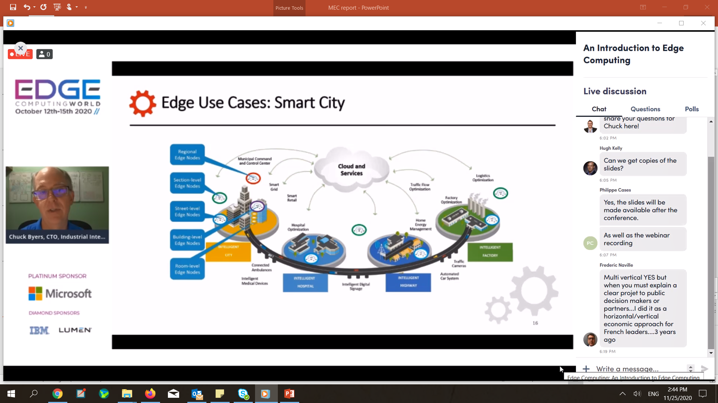

Slide 15
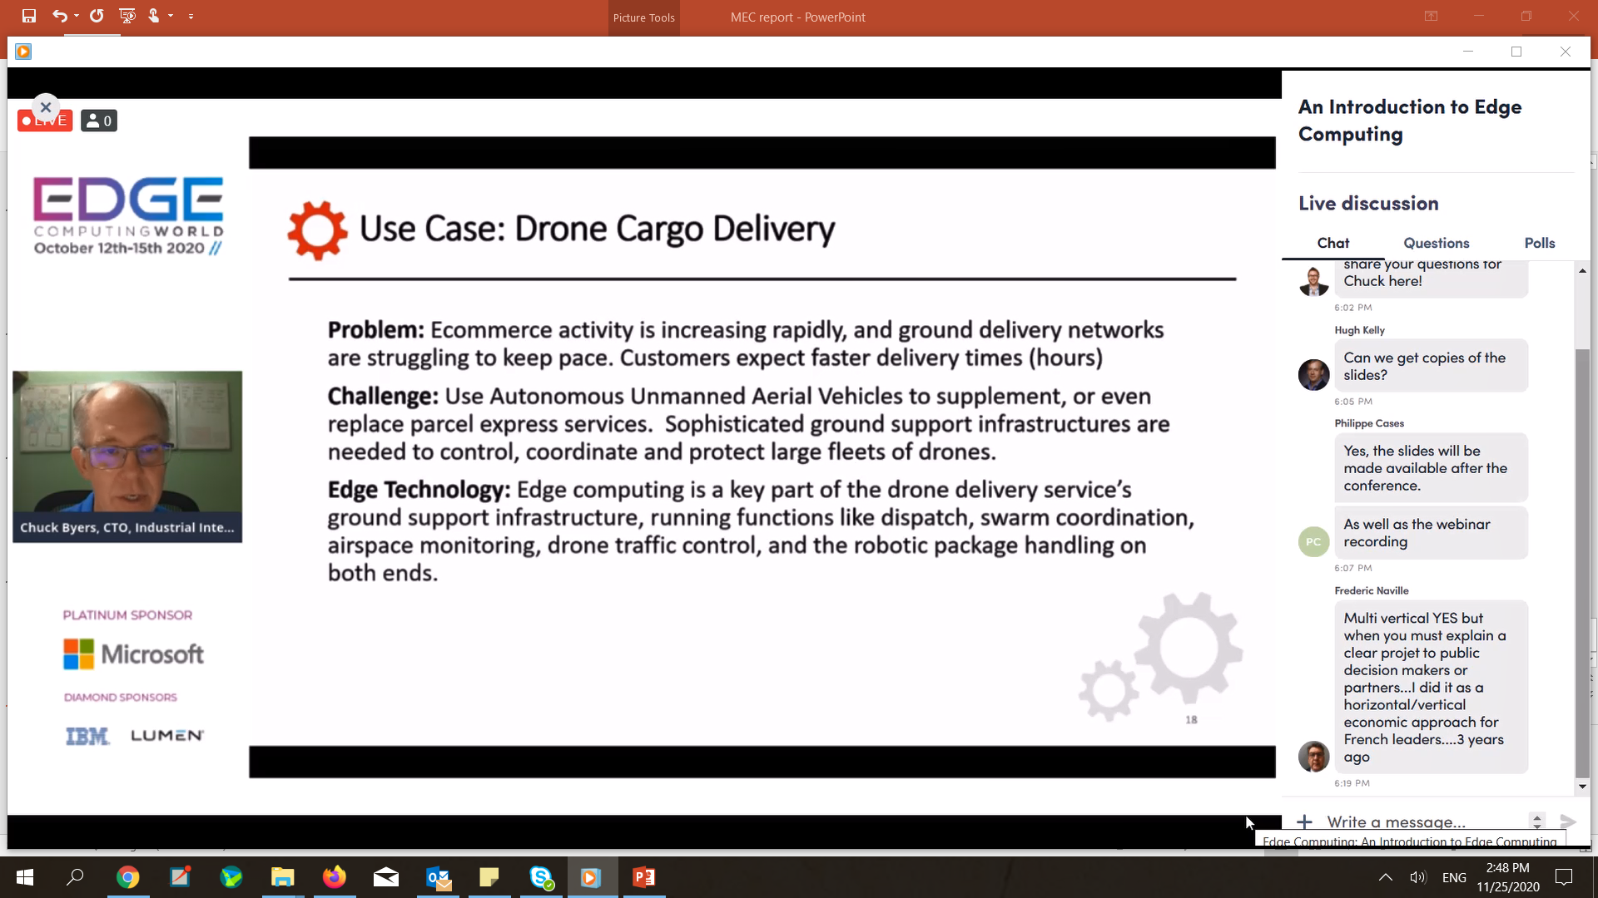

Slide 16
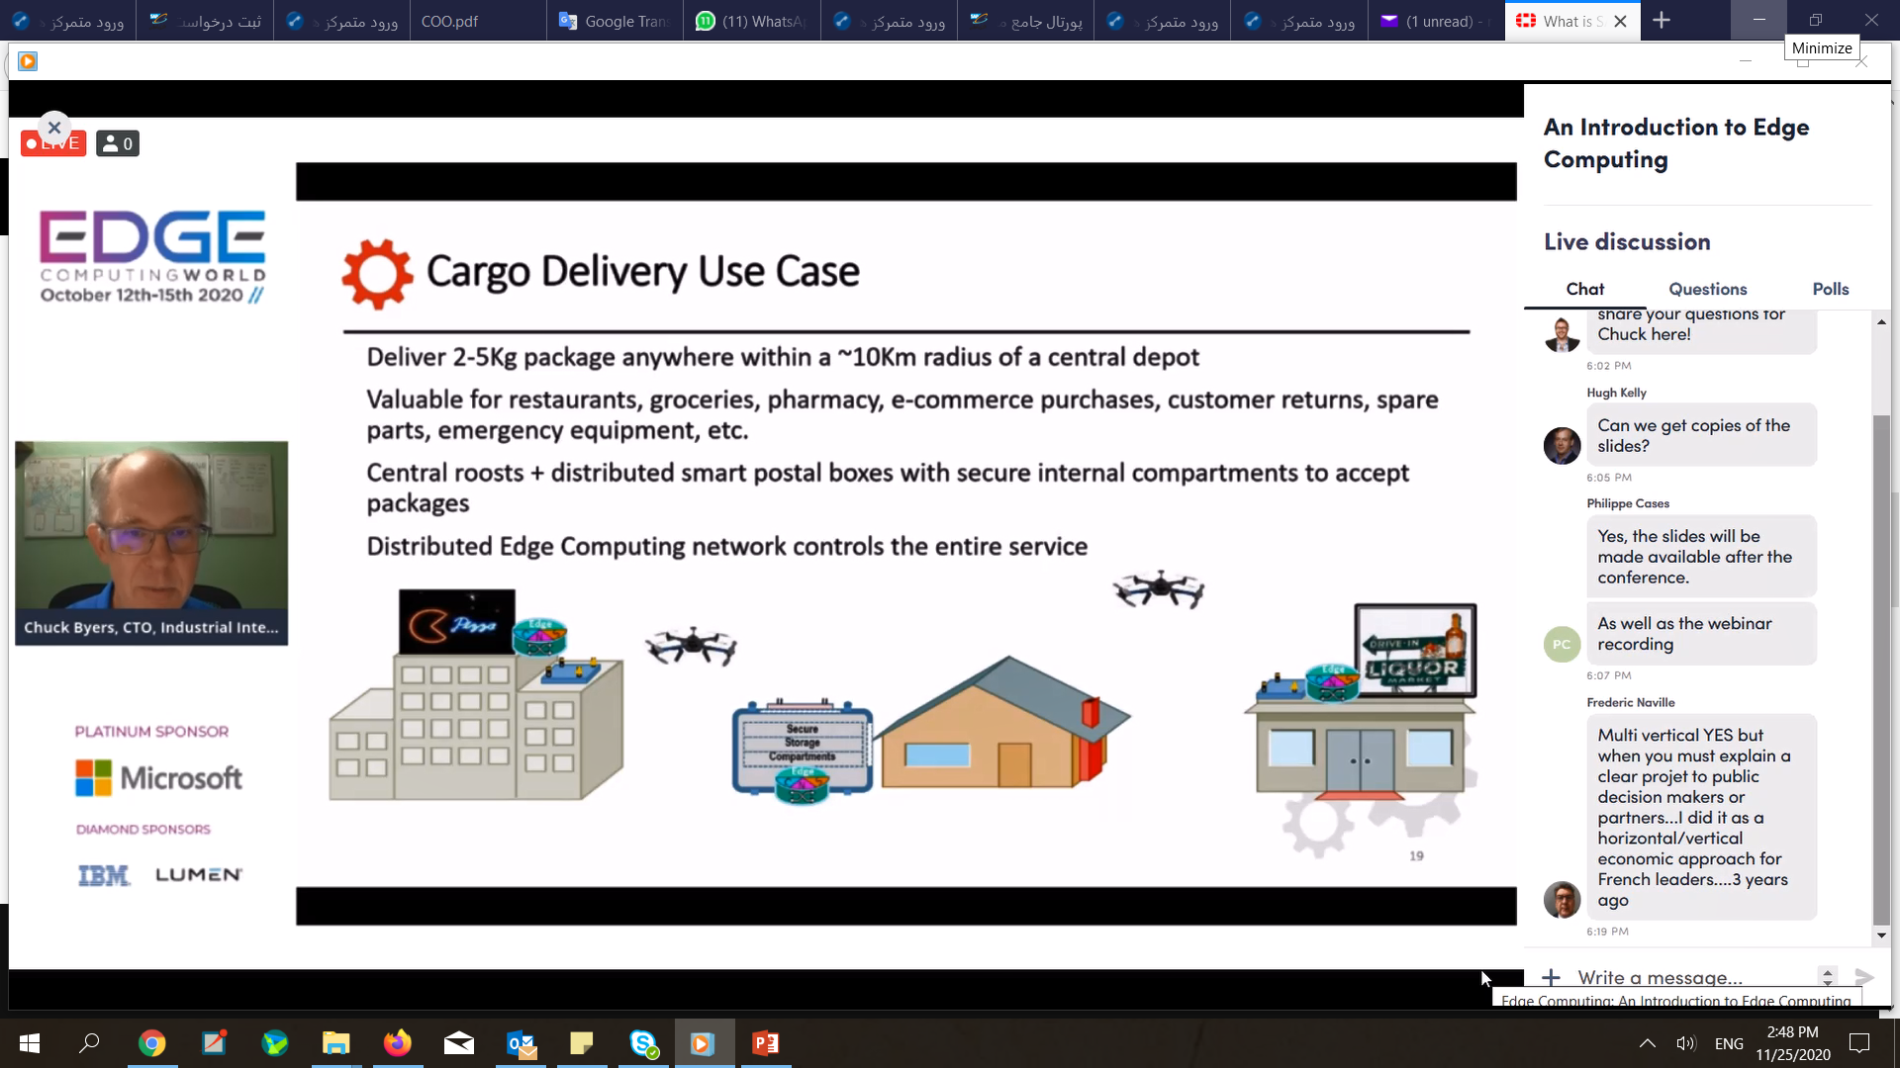
برای برج میلاد

Slide 17
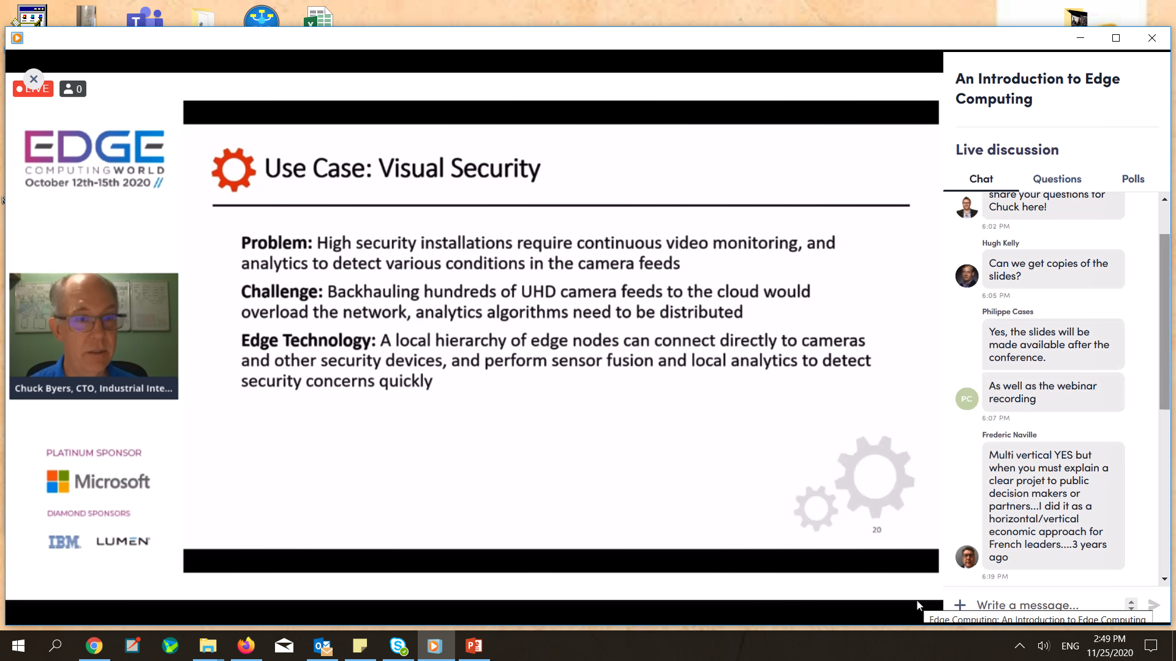

Slide 18
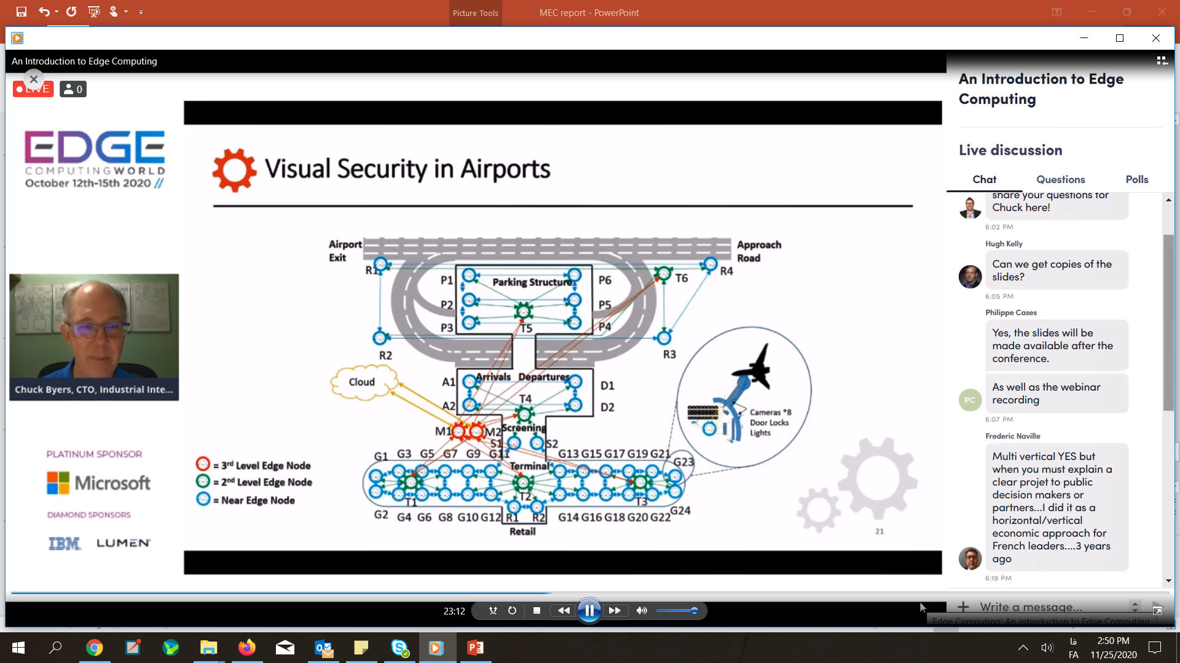

Slide 19
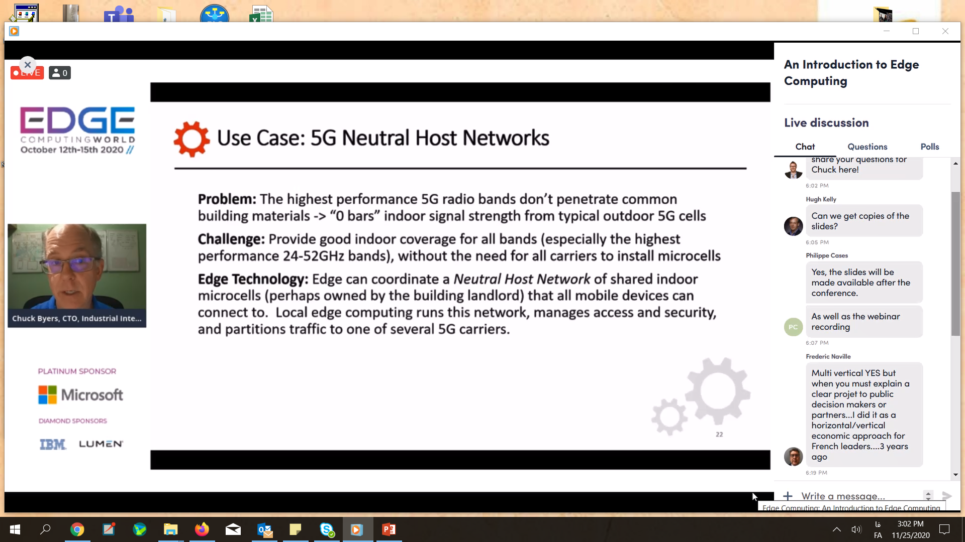

Slide 20
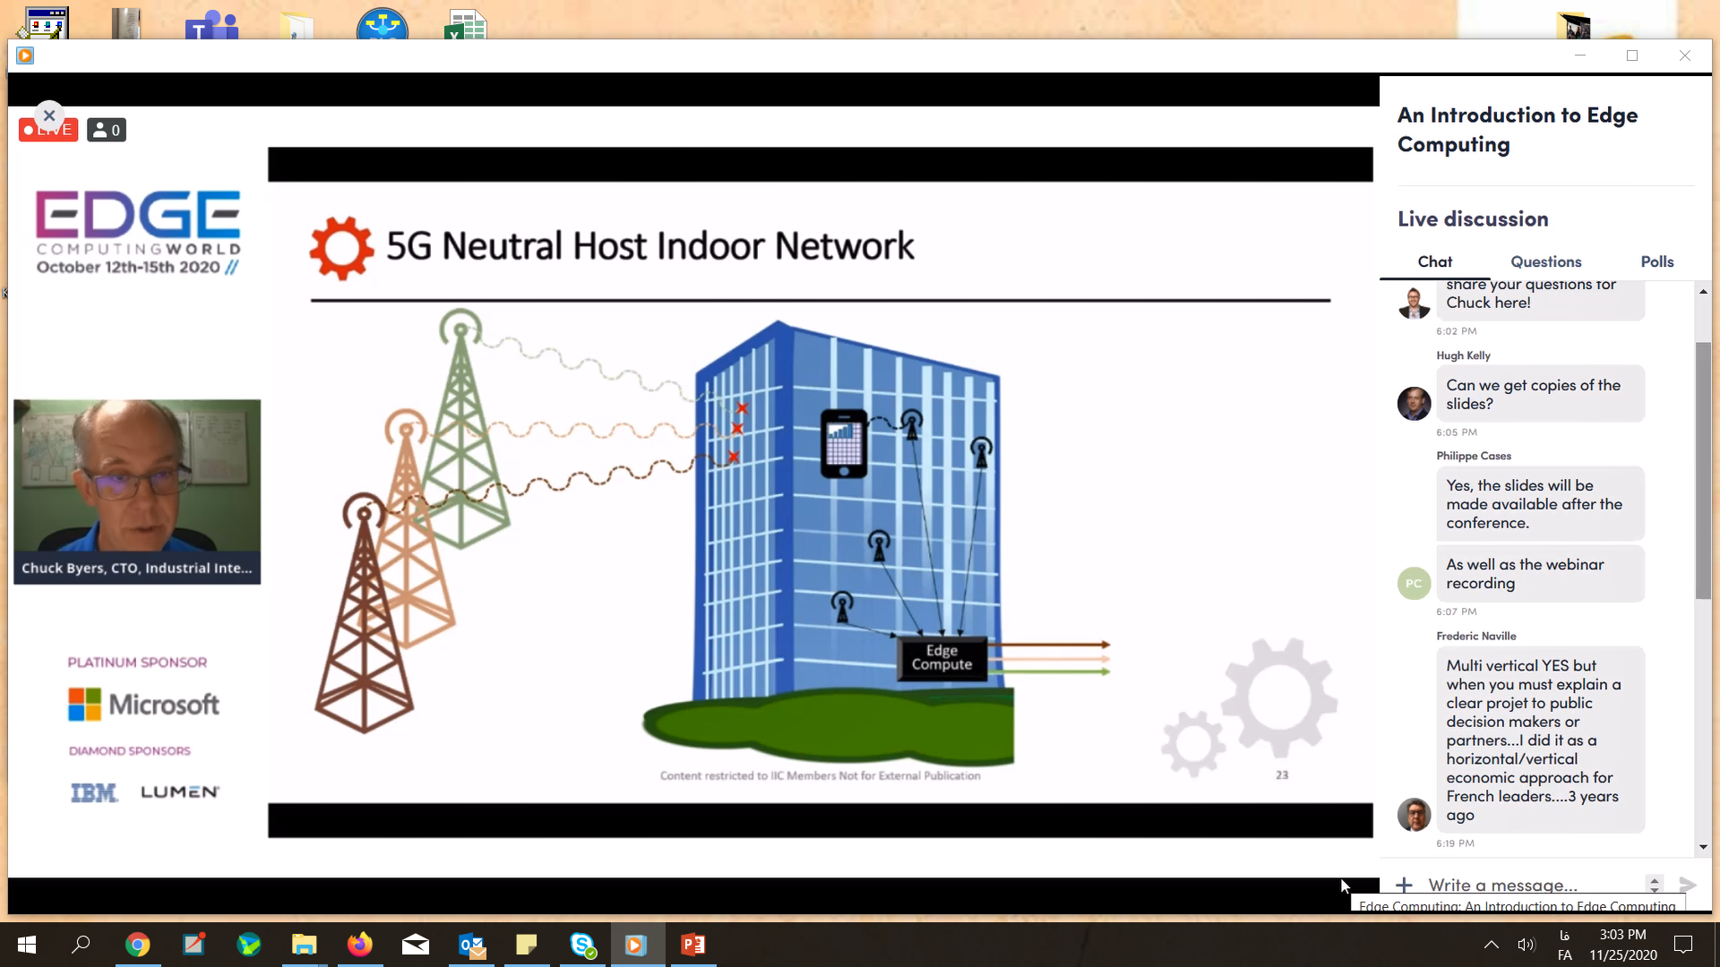

Slide 21
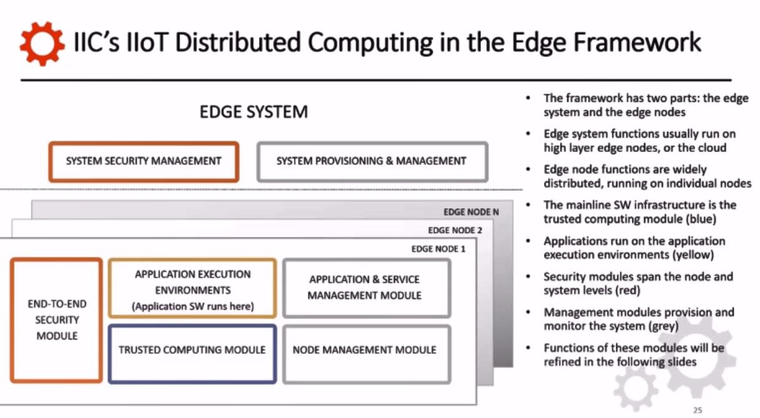

Slide 22
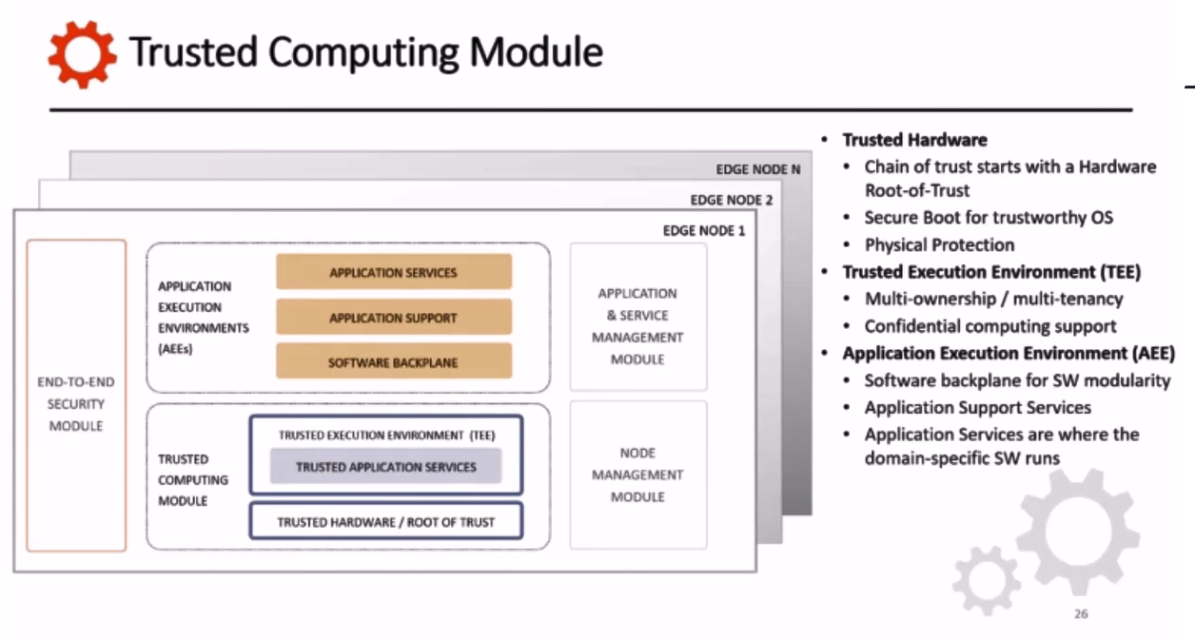

Slide 23
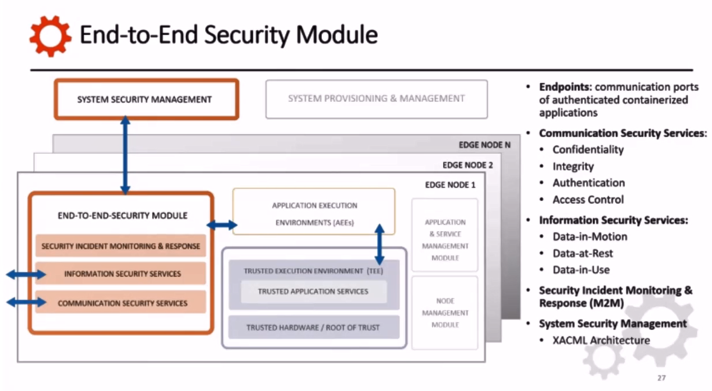

Slide 24
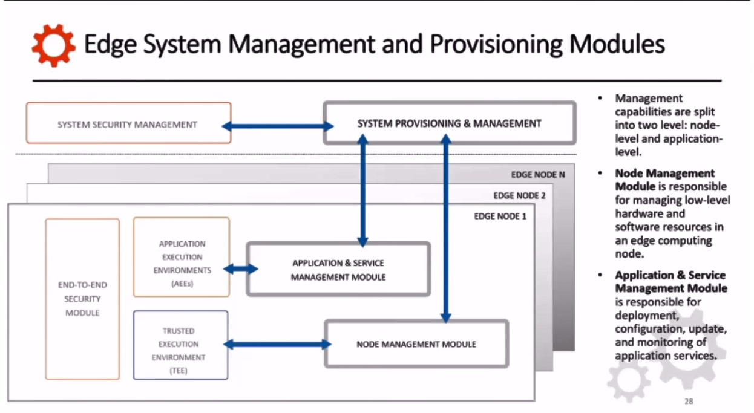

Slide 25
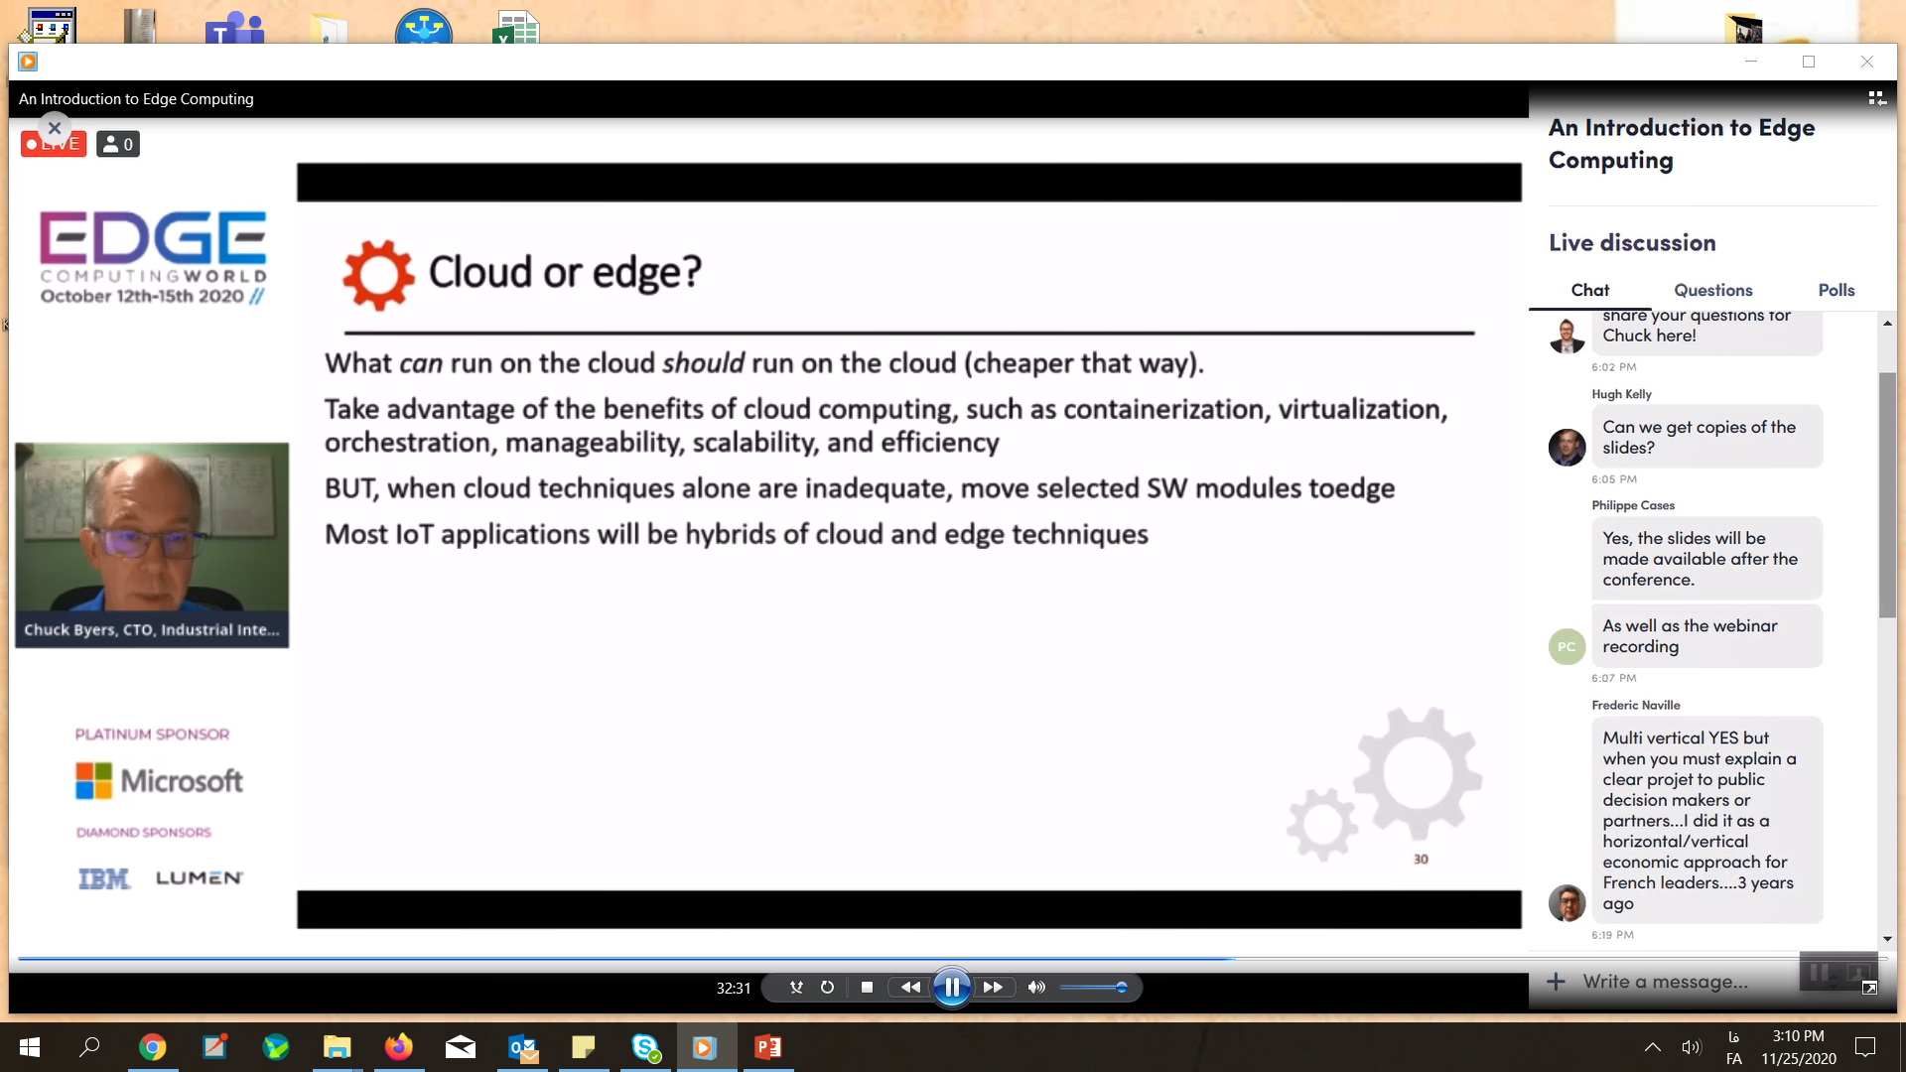
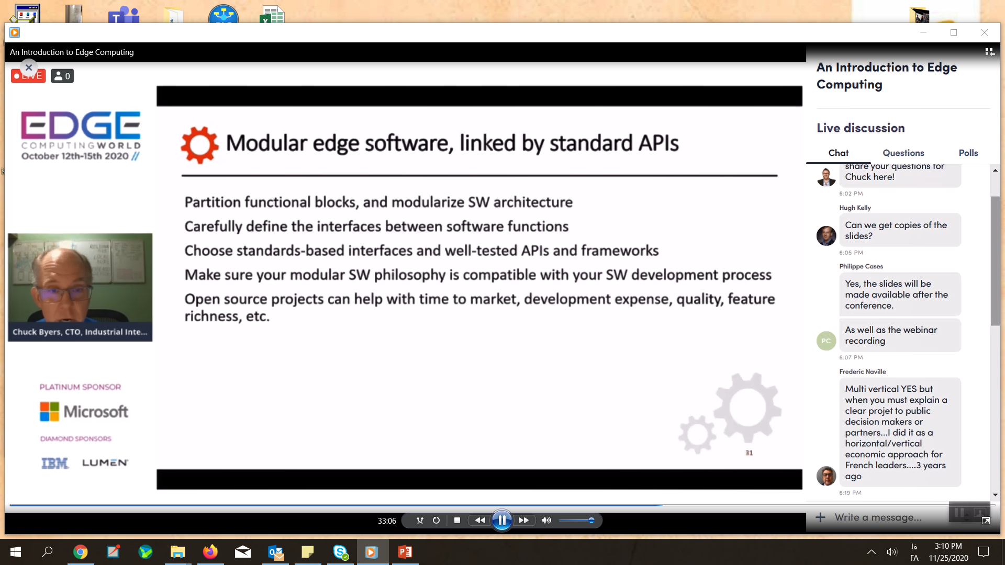

Slide 26
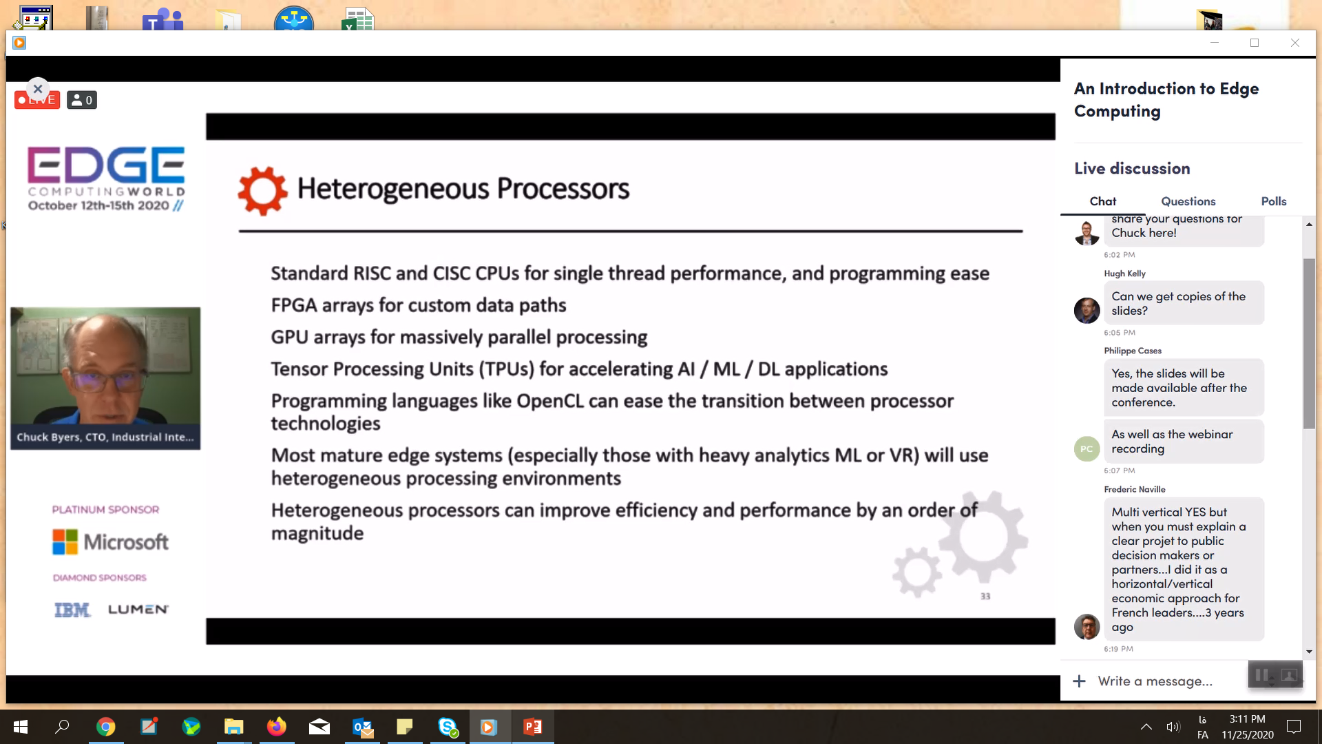

Slide 27
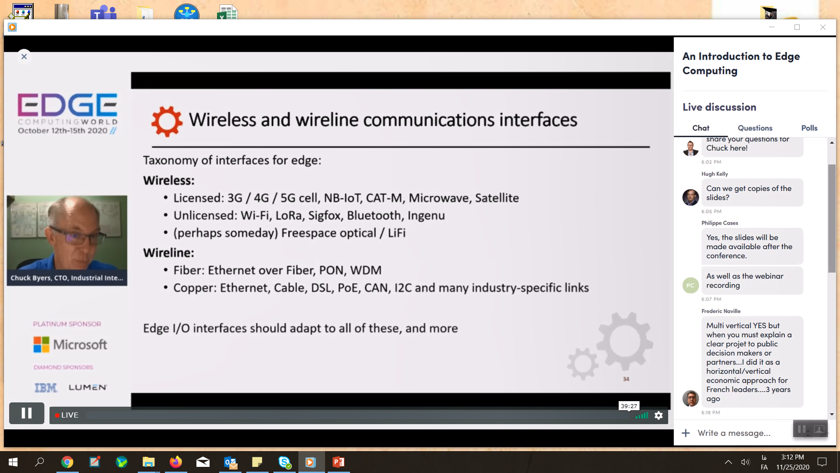

Slide 28
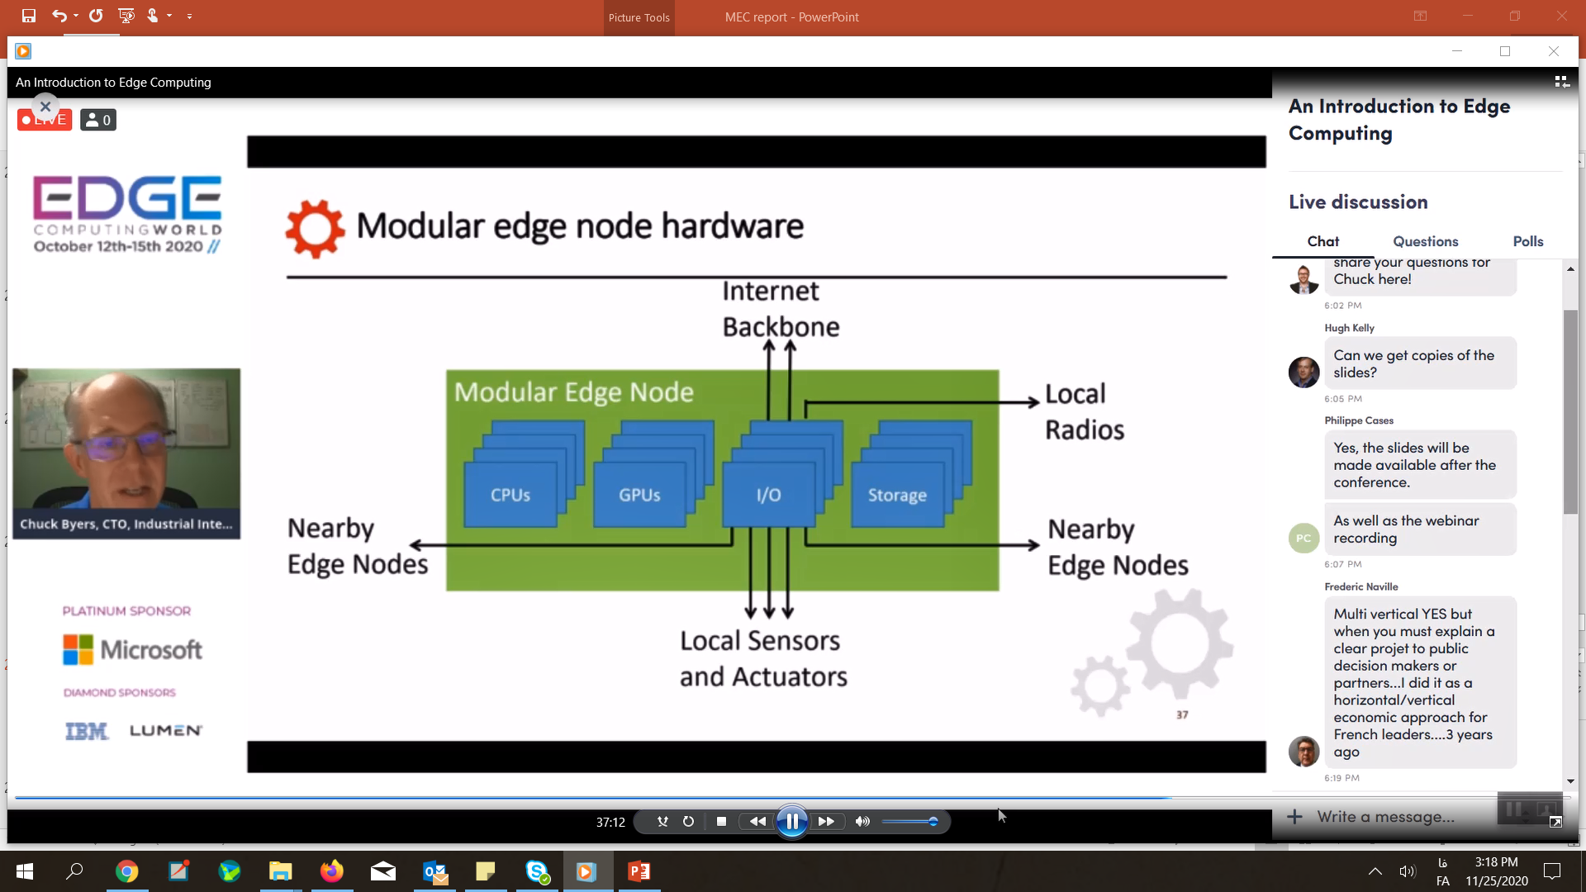

Slide 29
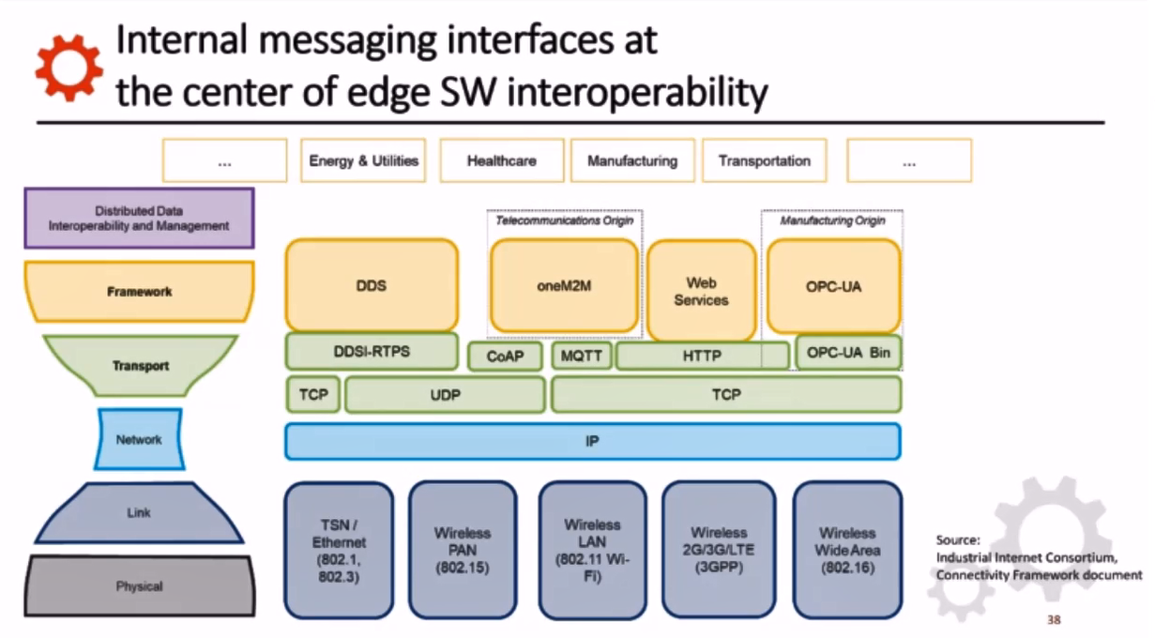

Slide 30
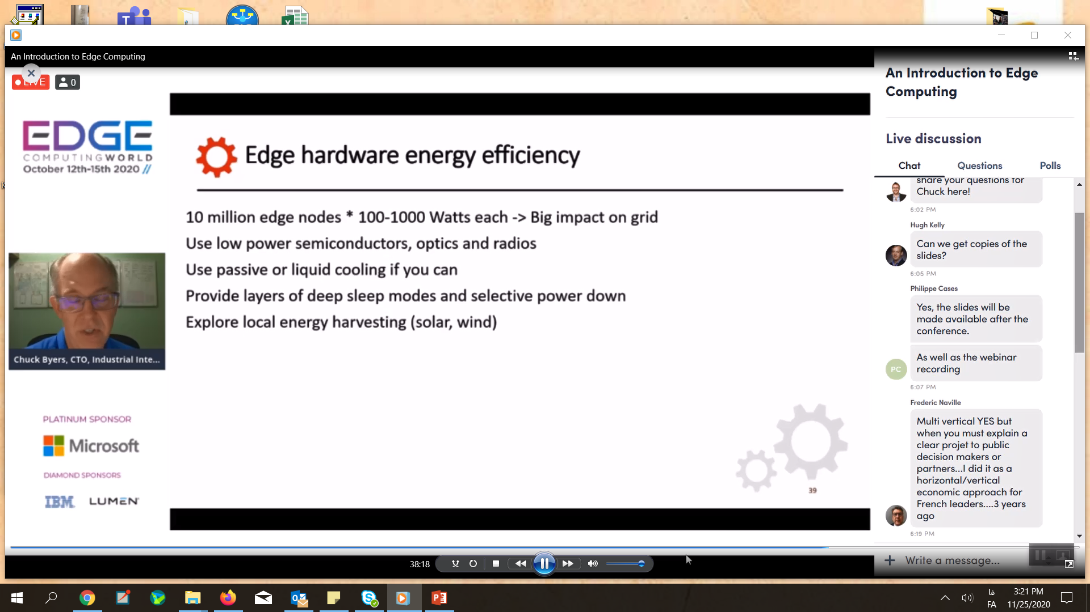

Slide 31
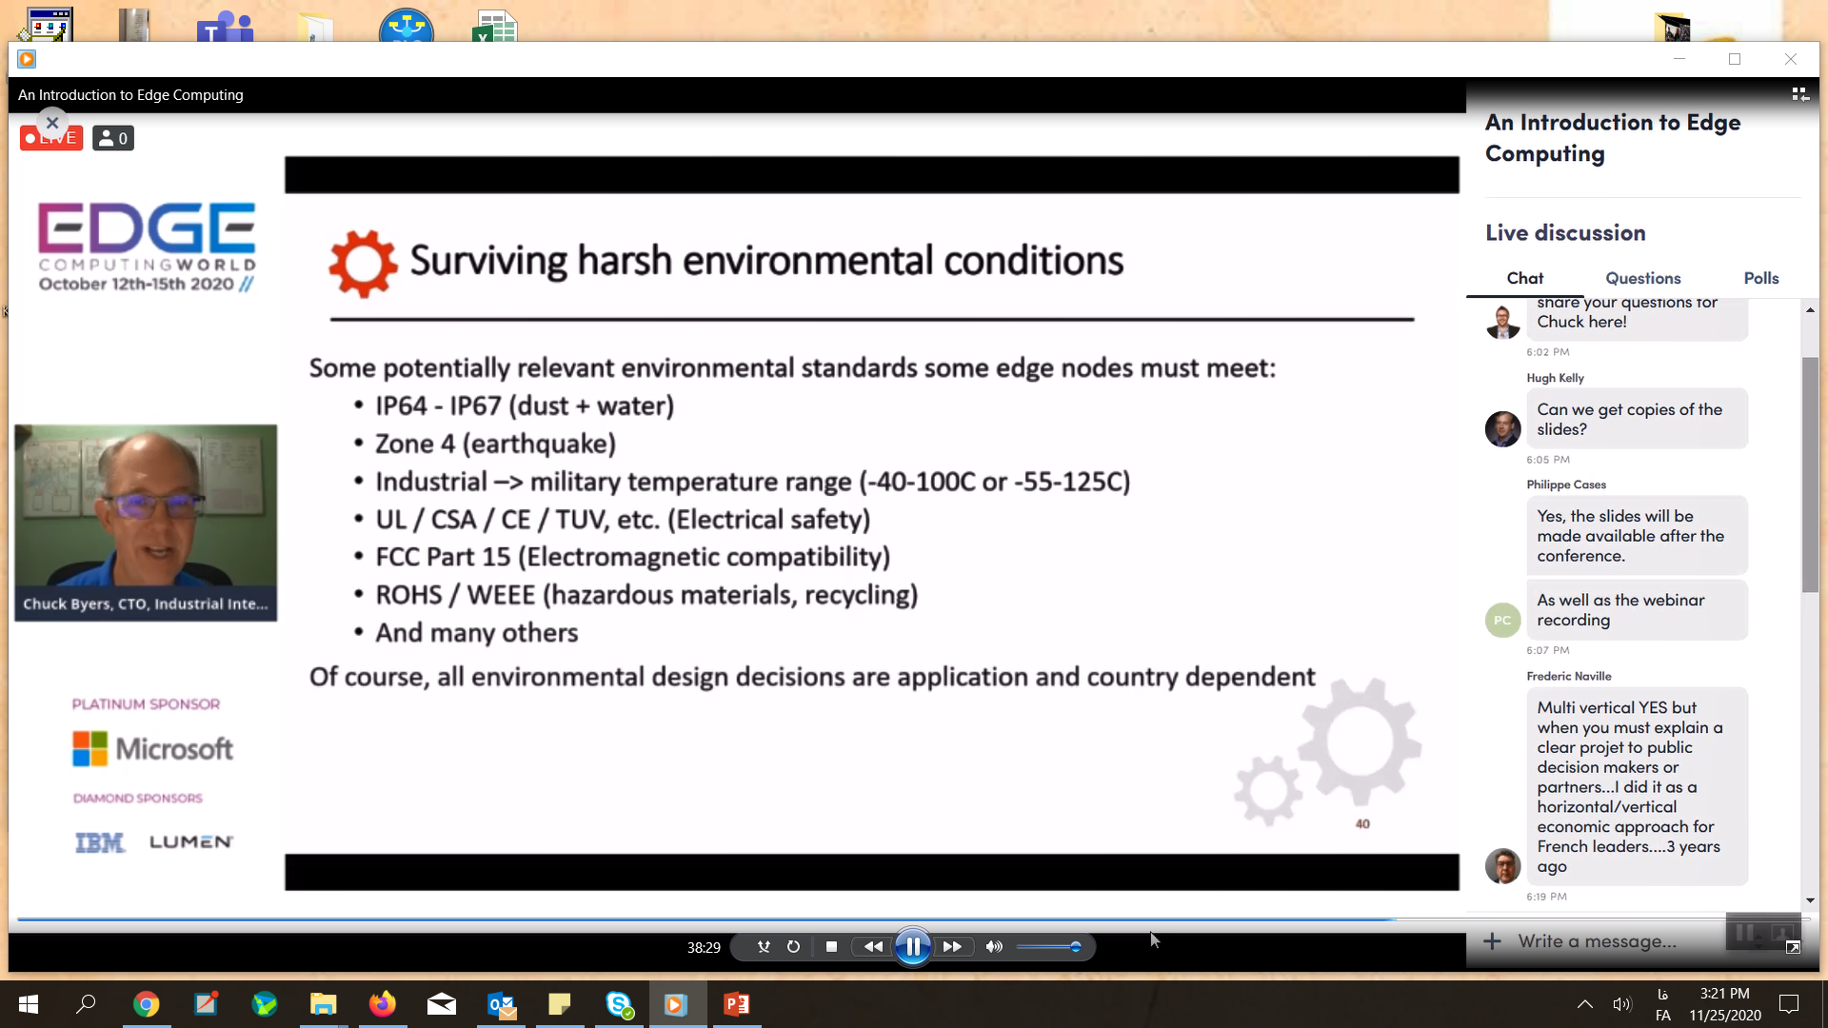

Slide 32
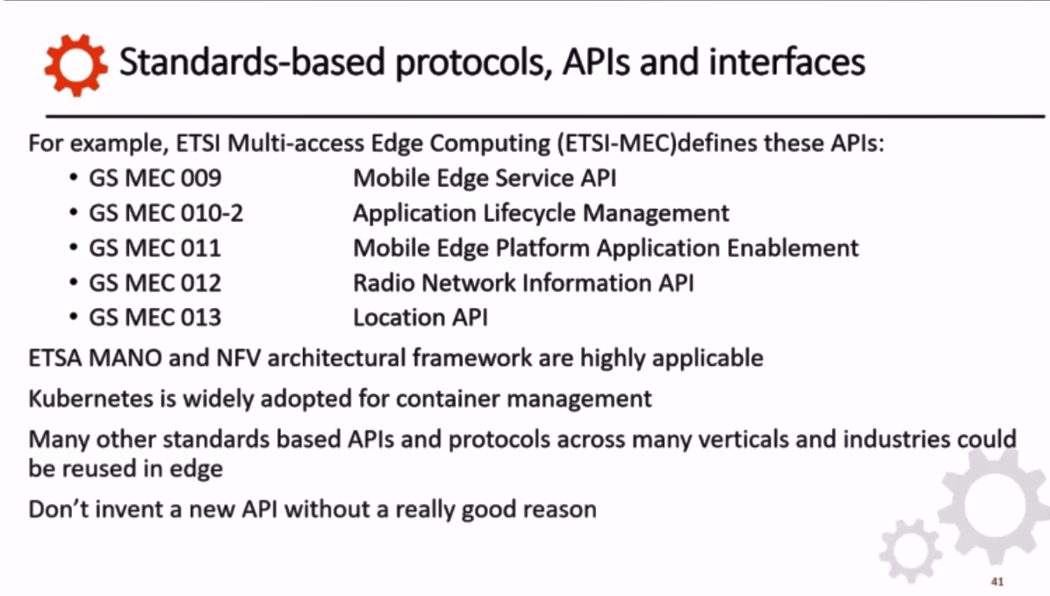

Slide 33
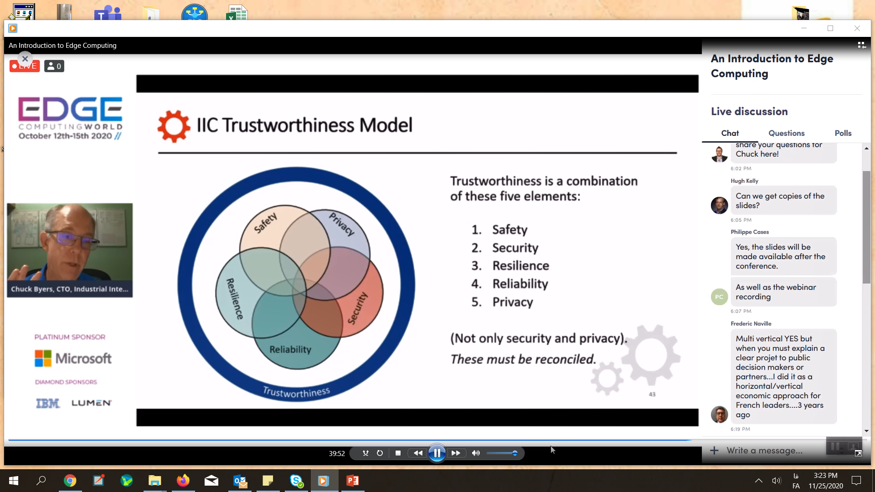
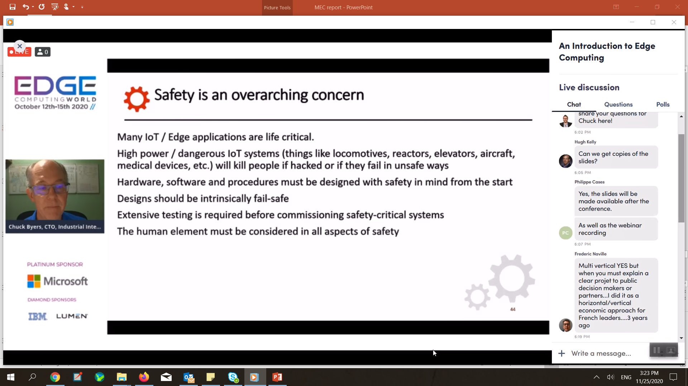
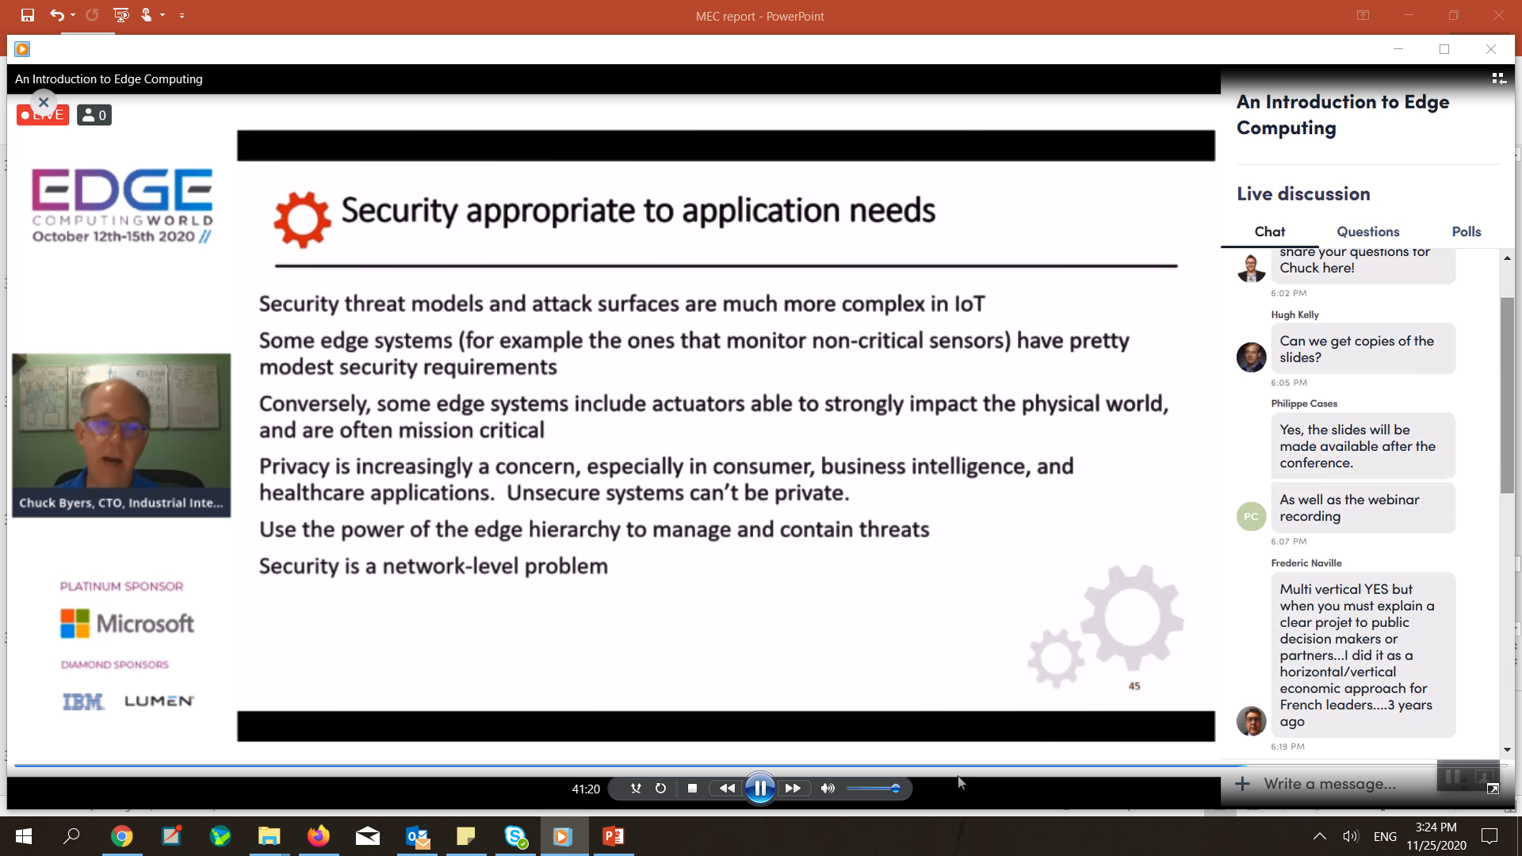

Slide 34
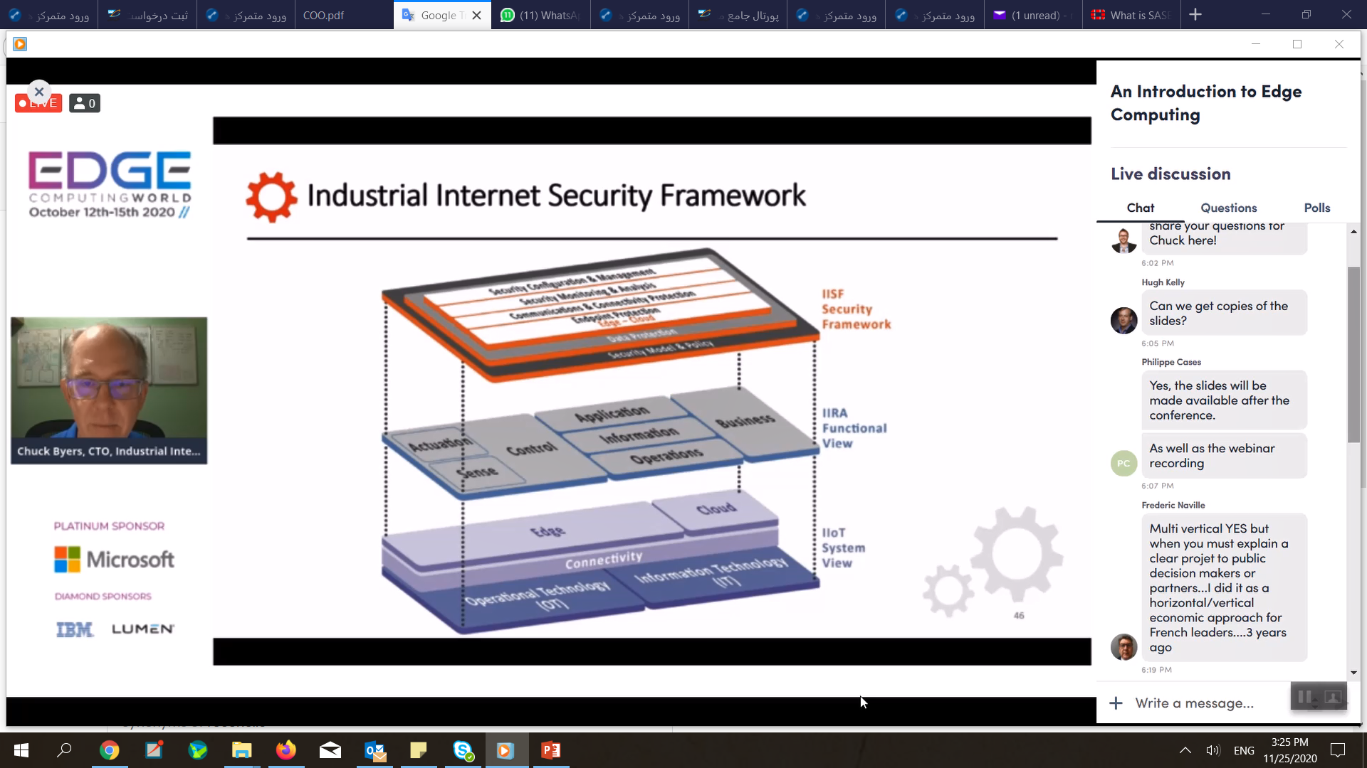

Slide 35
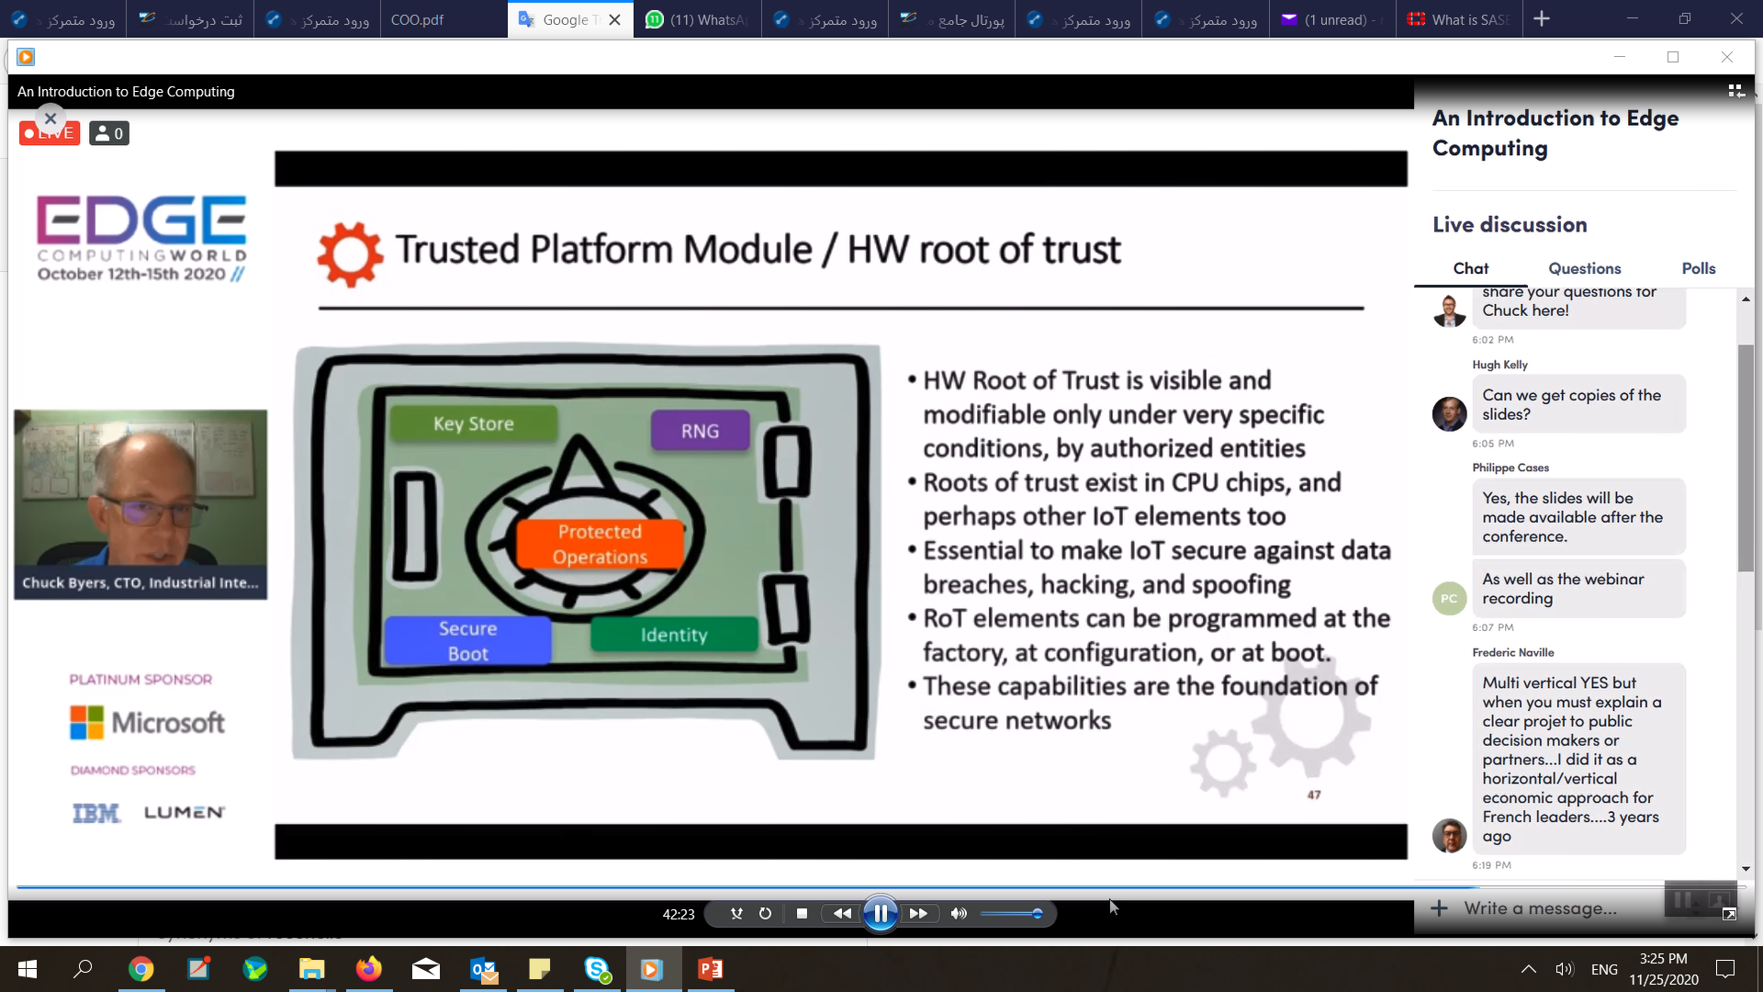

Slide 36
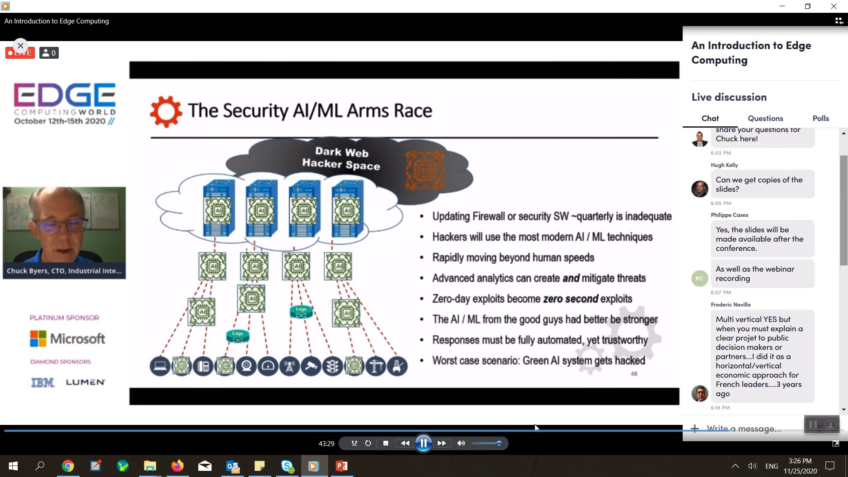

Slide 37
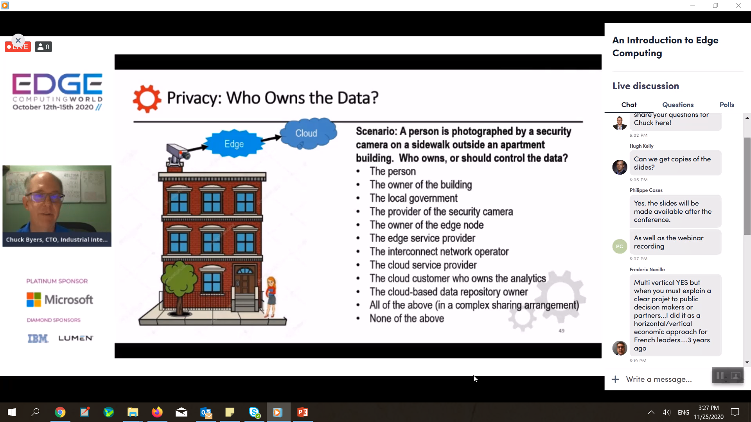

Slide 38
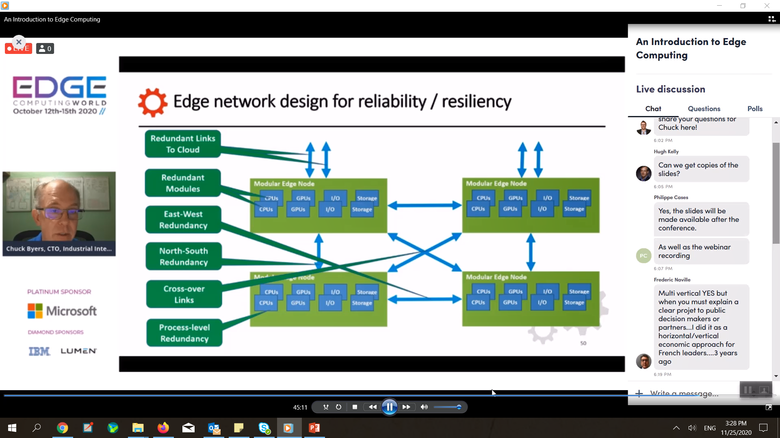

Slide 39
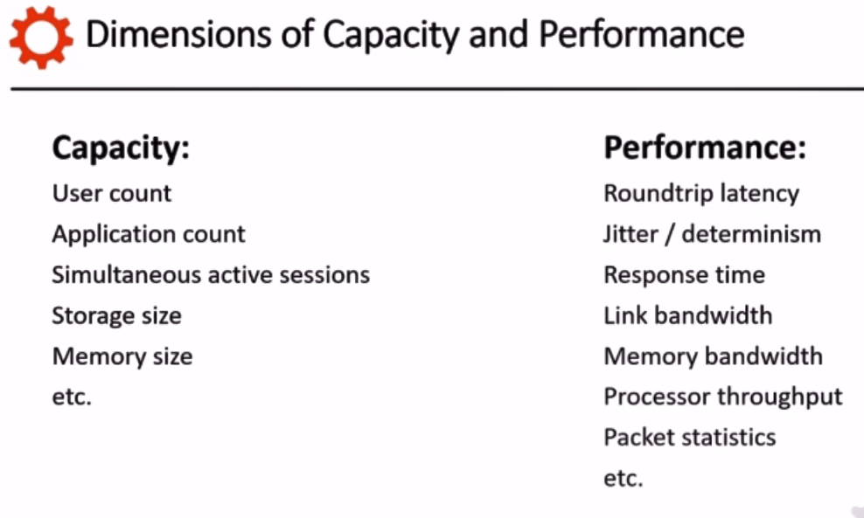

Slide 40
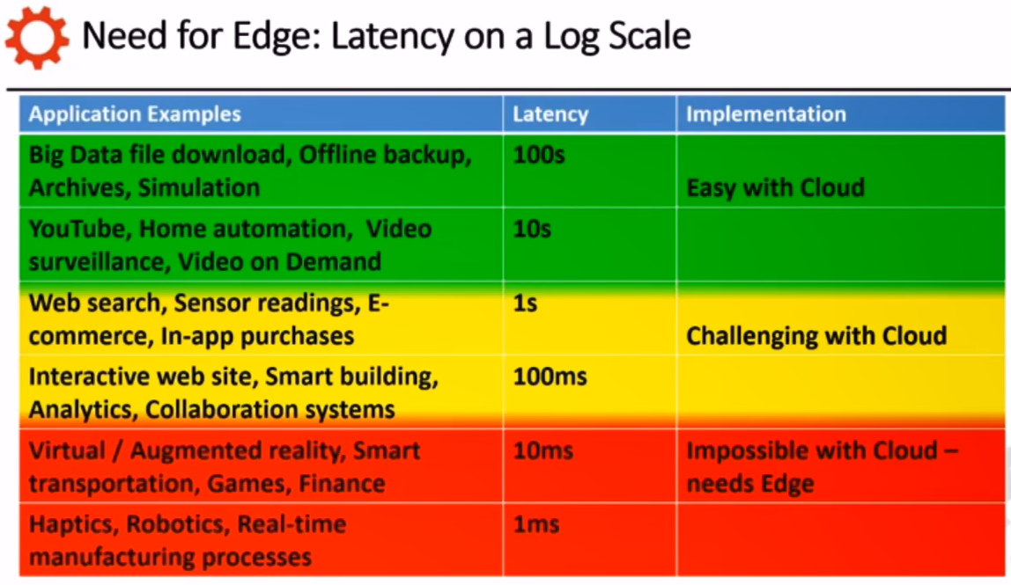

Slide 41
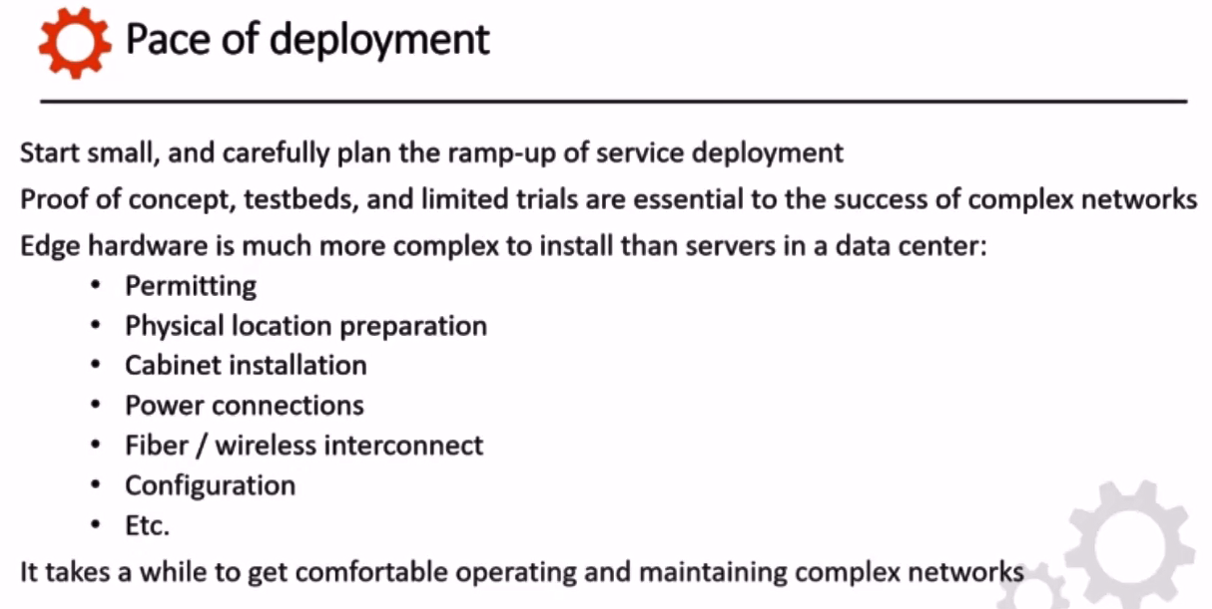

Slide 42
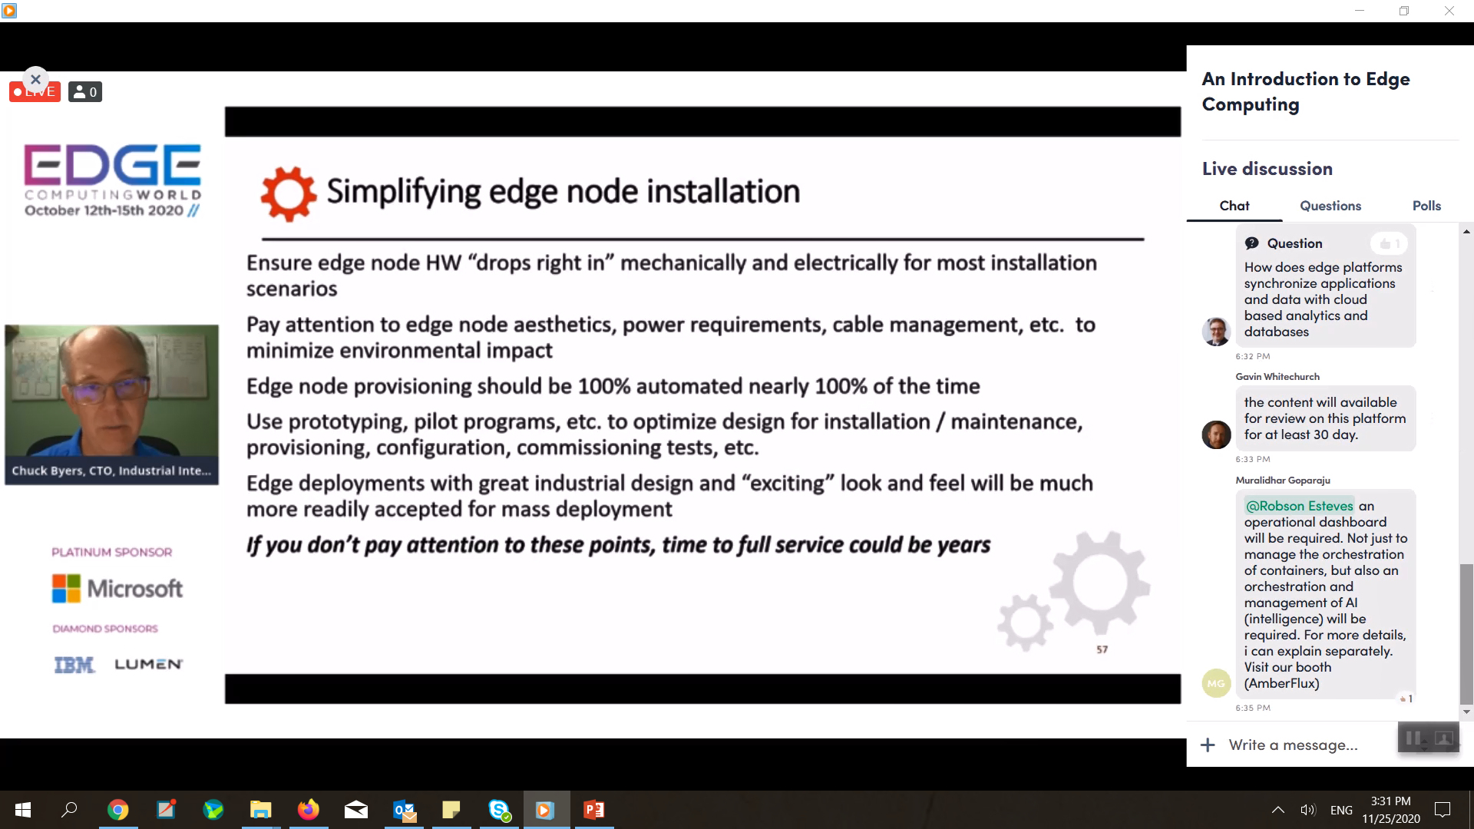

Slide 43
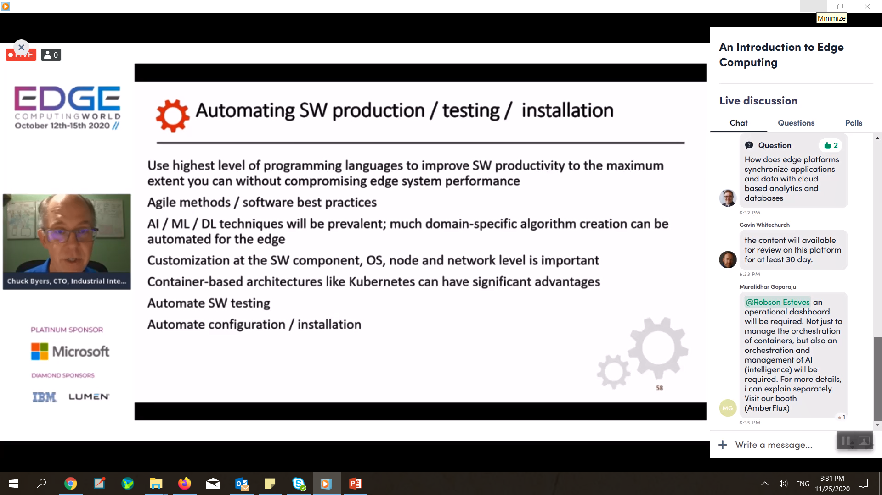

Slide 44
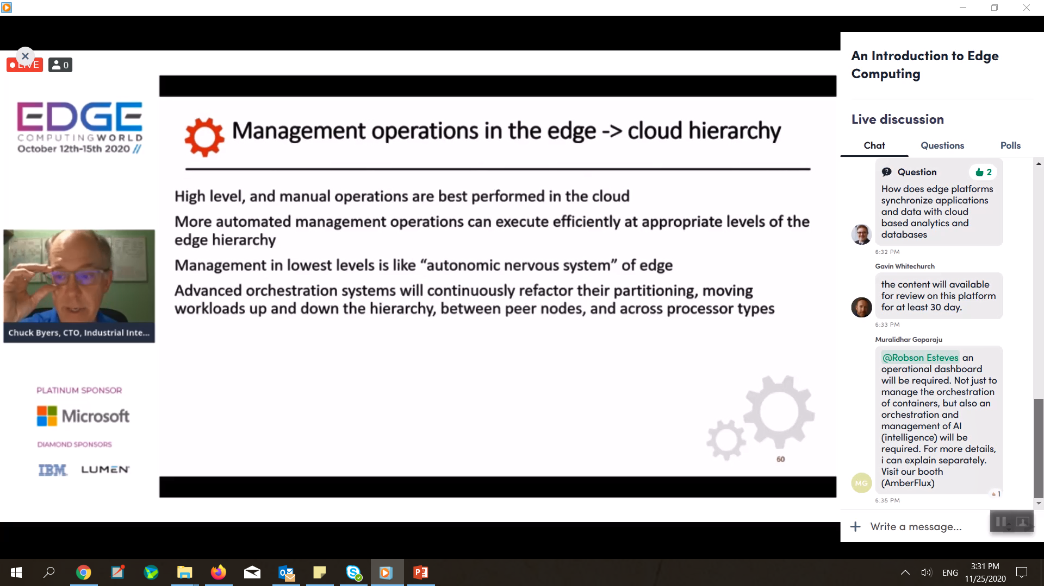

Slide 45
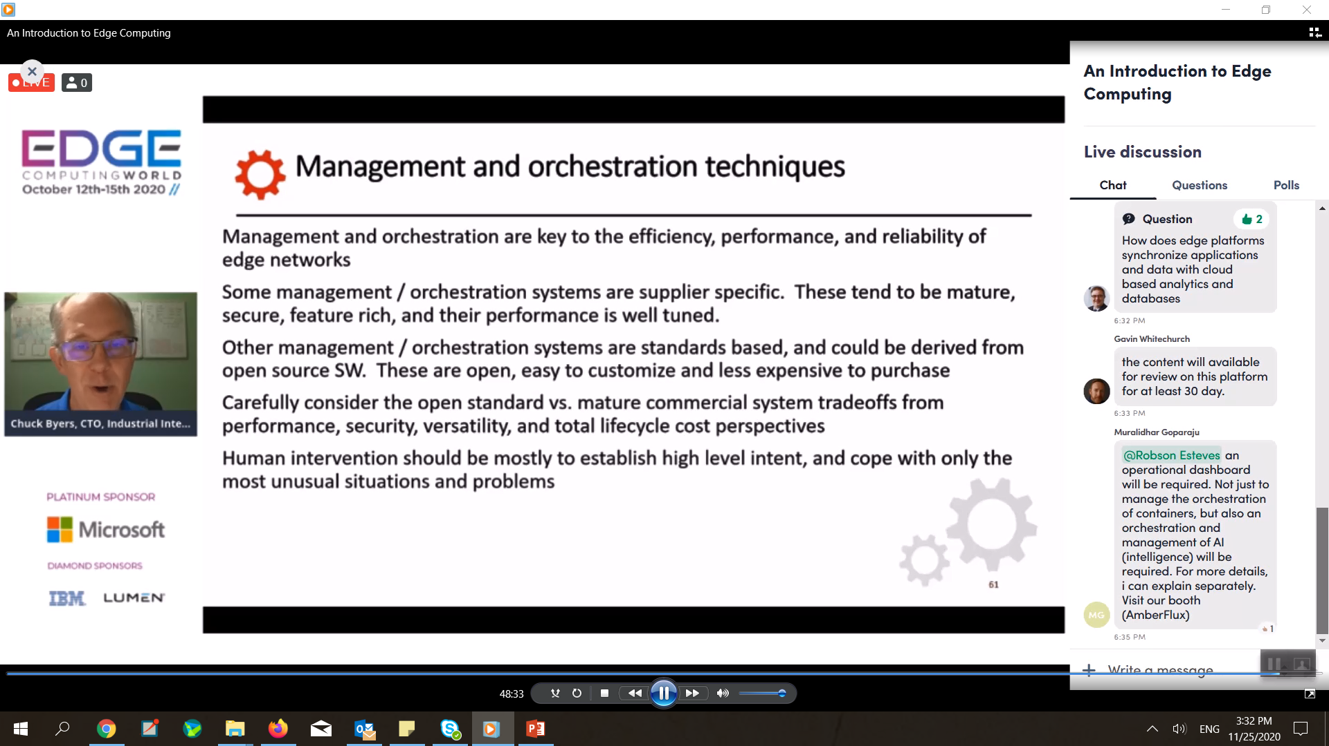

Slide 46
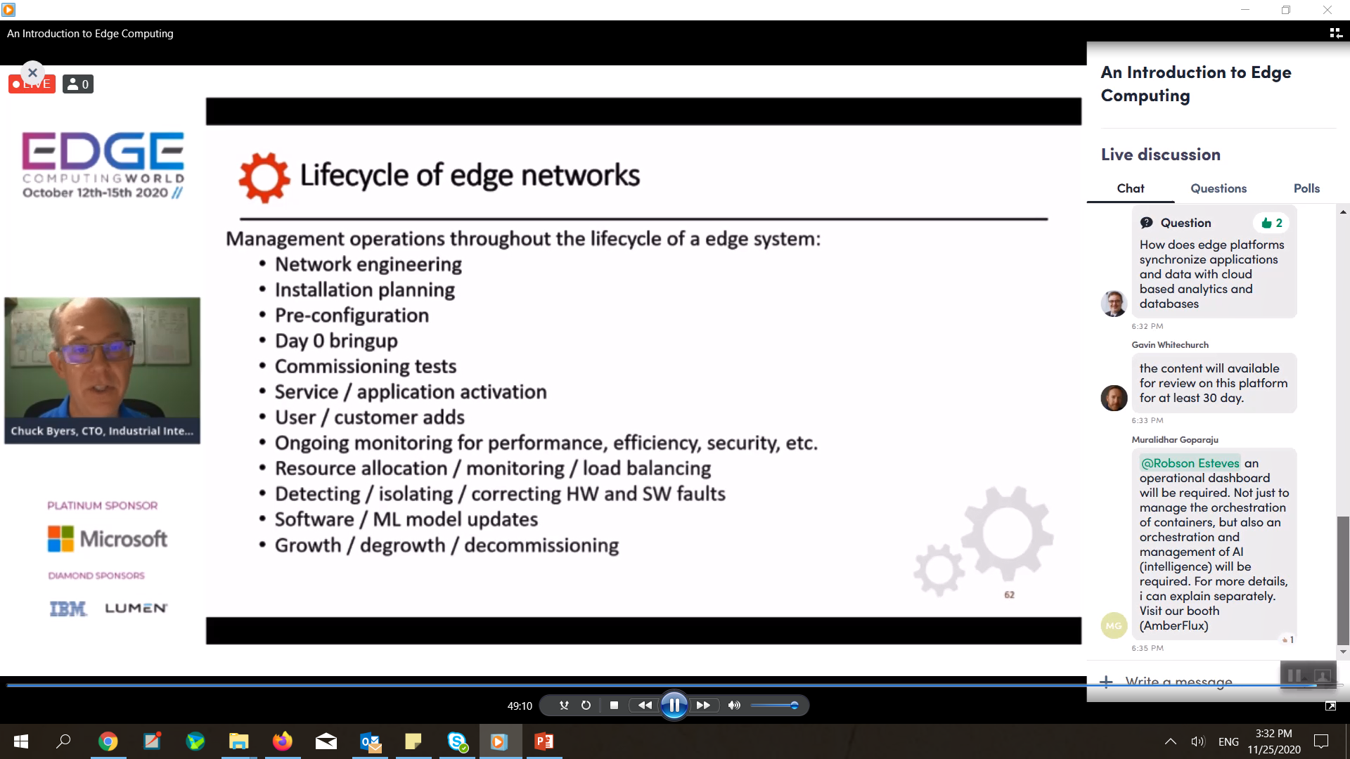

Slide 48
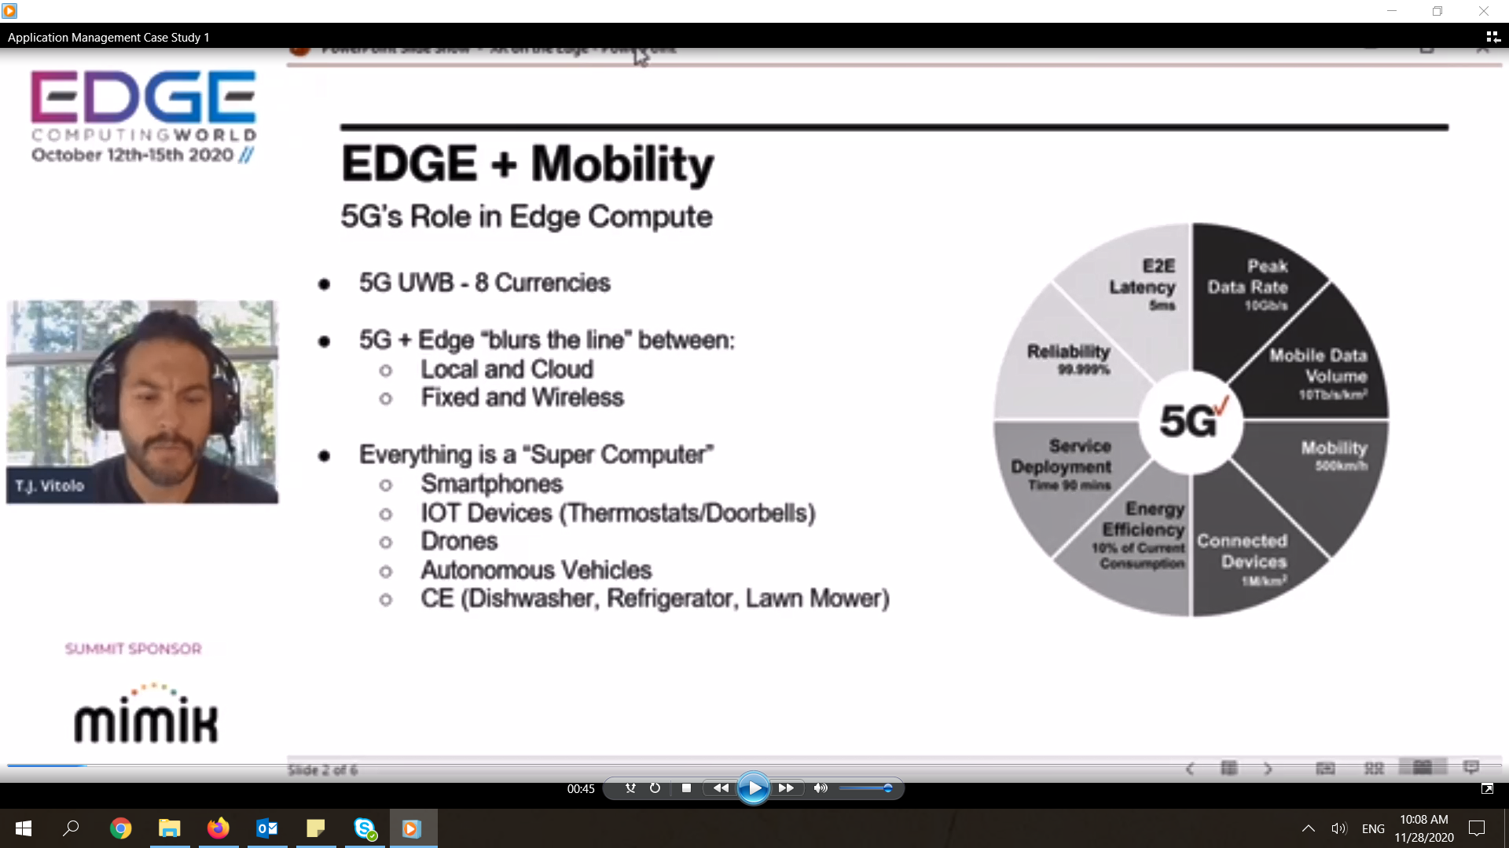

Slide 49
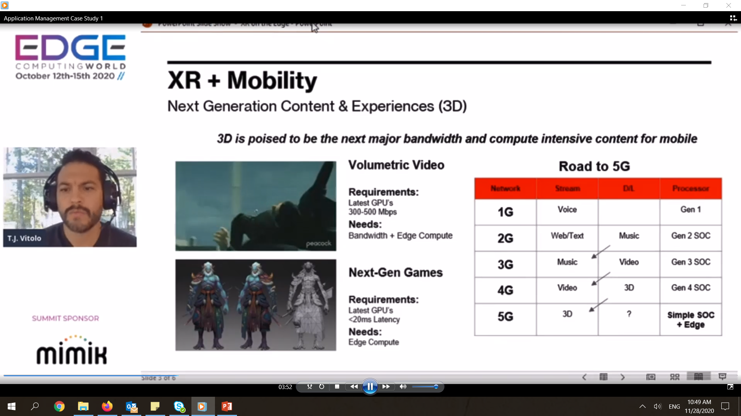

Slide 50
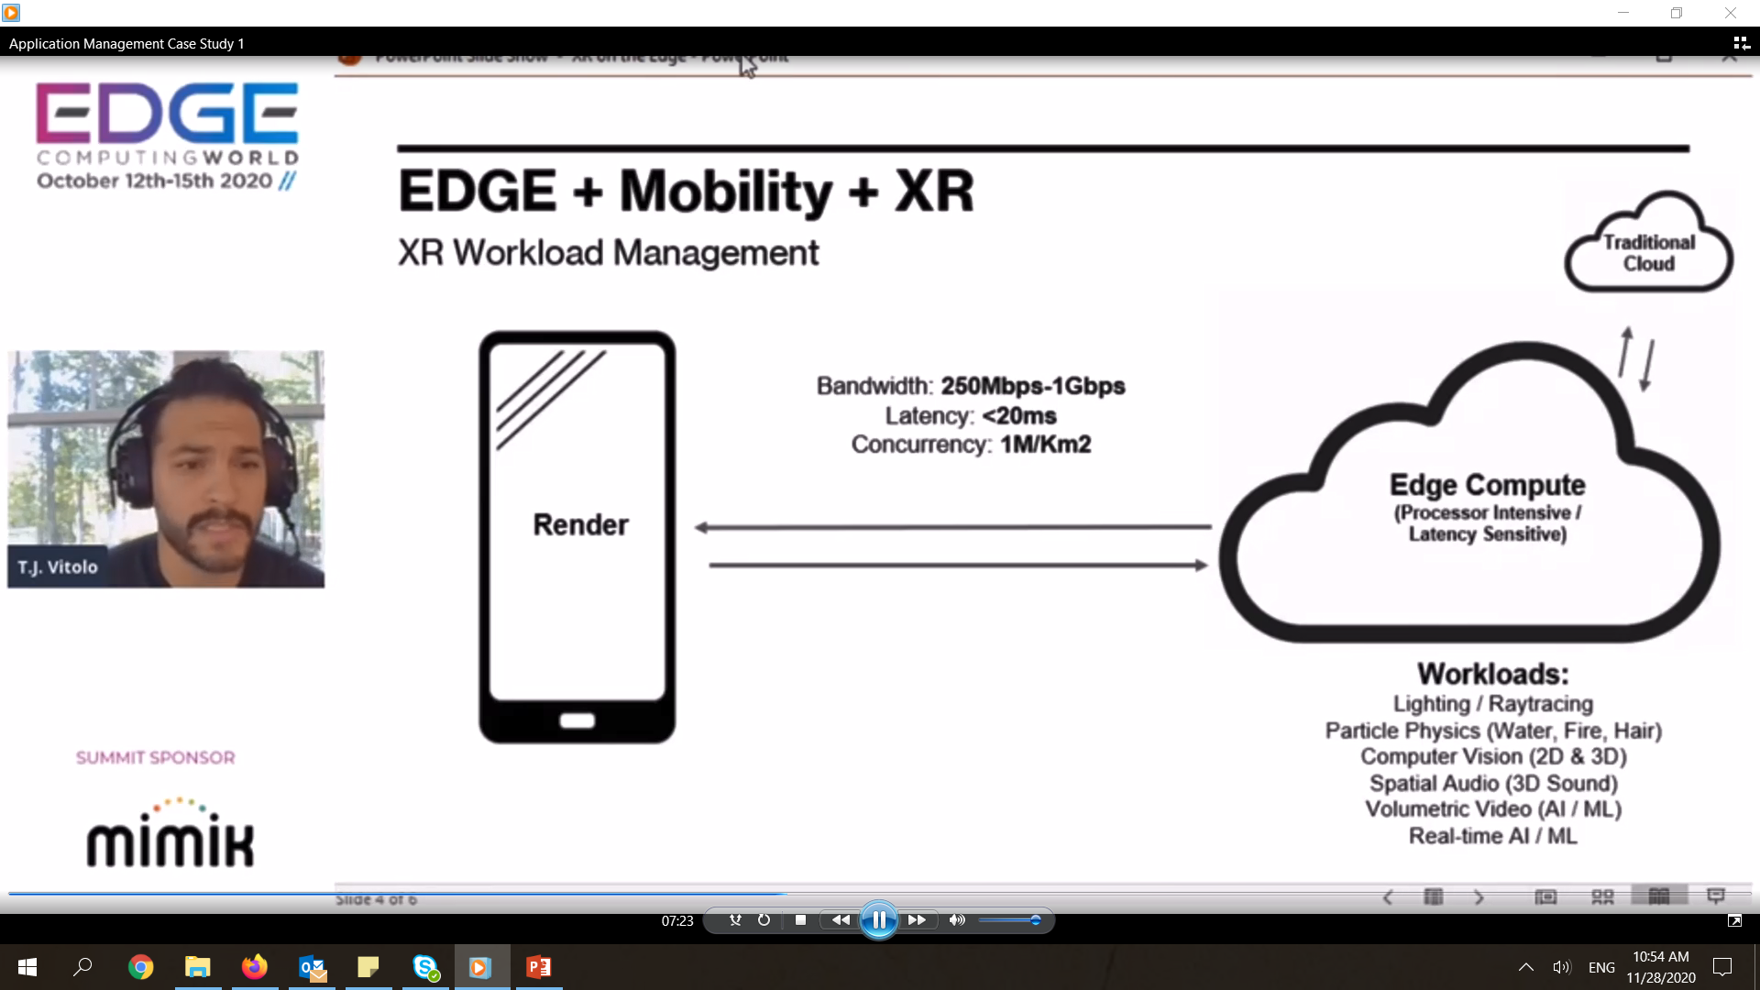

Slide 51


Slide 52


Slide 53


Slide 54


Slide 55


Slide 56


Slide 57


Slide 58




Slide 59





Slide 60



Slide 61


Slide 62


Slide 63


Slide 64



Slide 65



Slide 66


Slide 67


Slide 68



Slide 69


Slide 70


Slide 71


Slide 72


